Slide 1
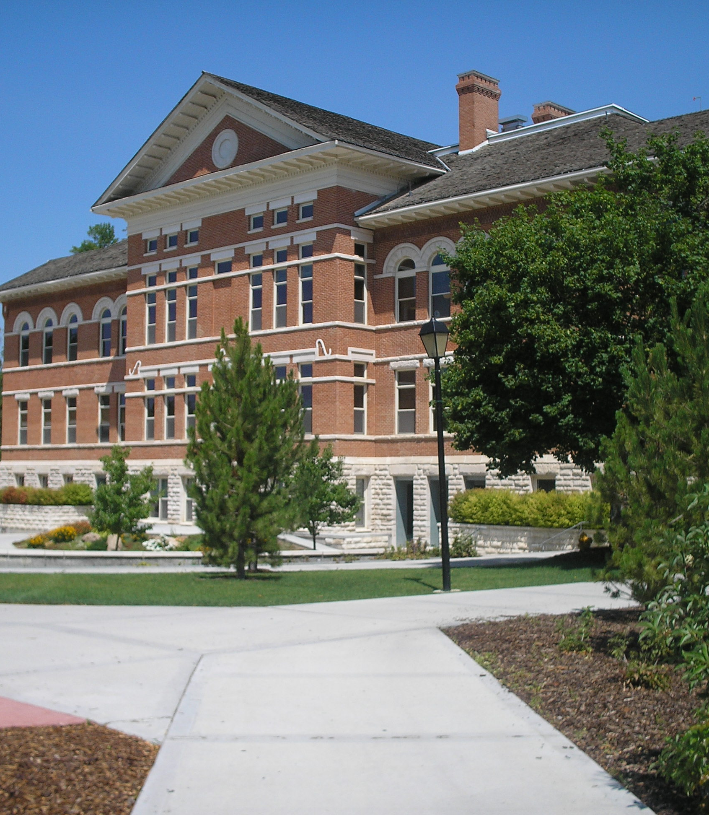
“How do I get other people to do my job?”
And other important delegation tips

Slide 2
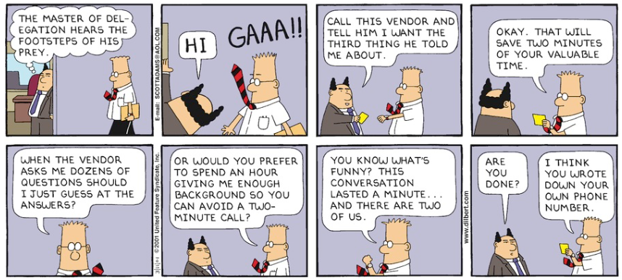

Slide 3
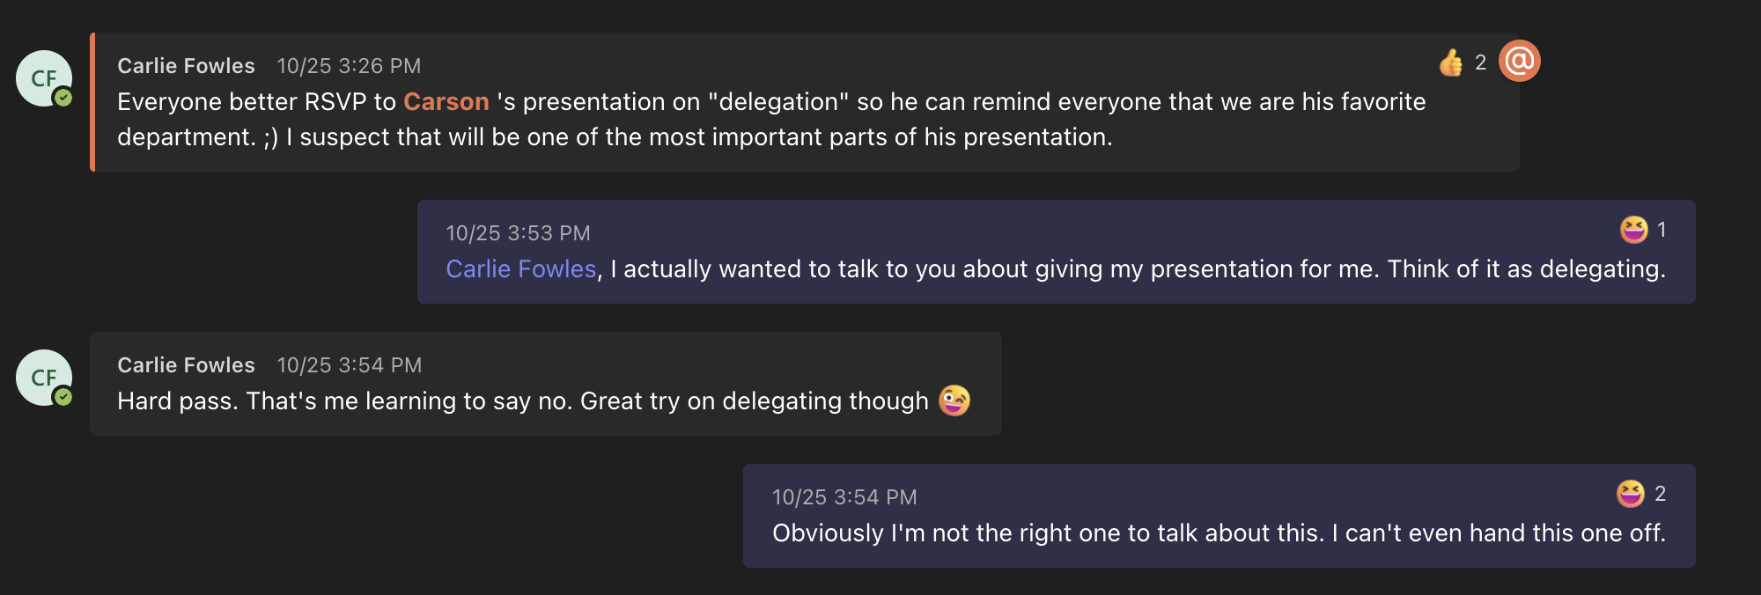
Let’s Talk About Delegation

Slide 4

Why is Delegation so Scary?

Slide 5
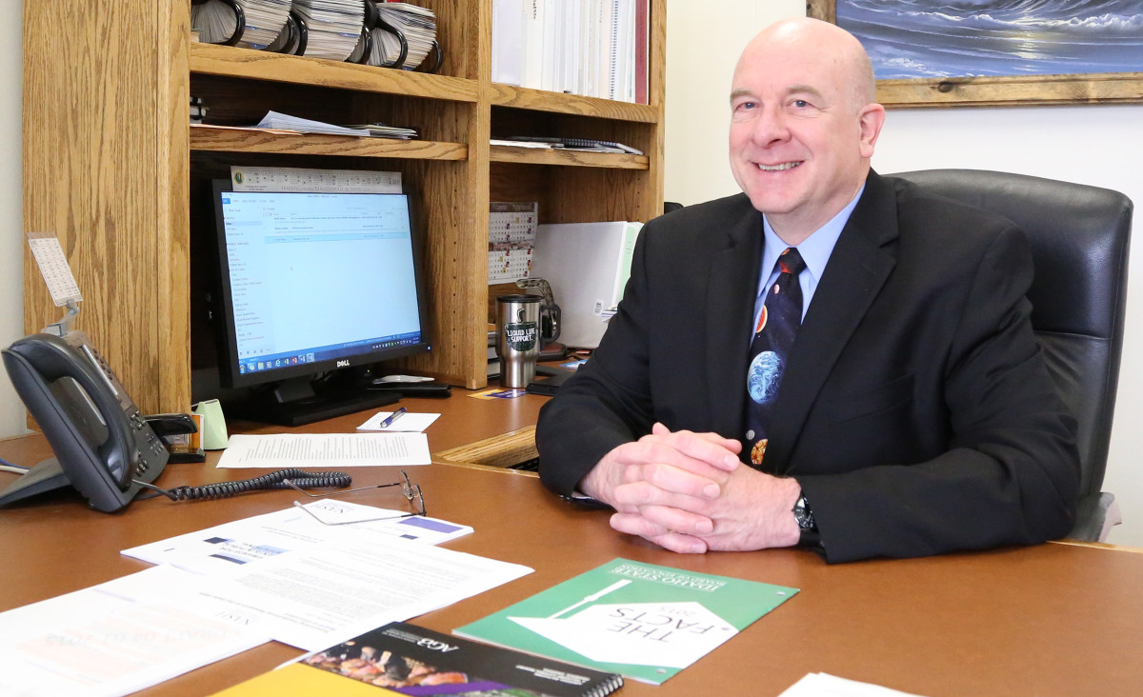
Mike’s Points to Ponder
8. If you say “it’s up to you”, be sure you can live with the consequences. It is okay to set up some parameters in advance, but after the fact changes will make people start second guessing you.

Slide 6

Special Napkins

Slide 7
10 Tips to Effectively Delegate Work
Identify Work to Delegate
Practice Letting Go
Clarify Priorities
Understand Each Team Member’s Strengths
Provide Context and Guidance
Invest in Training
Prioritize Communication and Feedback
Focus on Results
Trust but Verify
Give Credit Once Work is Completed

Slide 8


Slide 9

10 Tips to Effectively Delegate Work
Identify Work to Delegate
Practice Letting Go
Clarify Priorities
Understand Each Team Member’s Strengths
Provide Context and Guidance
Invest in Training
Prioritize Communication and Feedback
Focus on Results
Trust but Verify
Give Credit Once Work is Completed

Slide 10


Slide 11
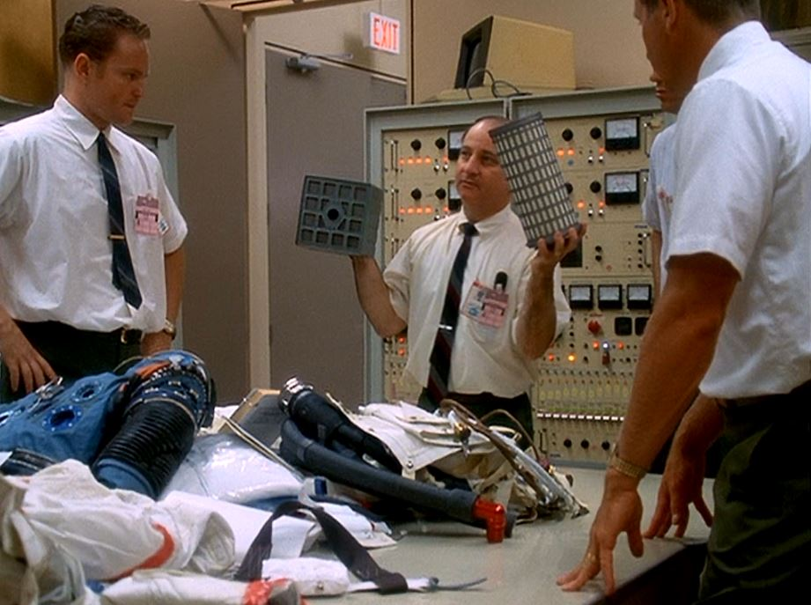
10 Tips to Effectively Delegate Work
Identify Work to Delegate
Practice Letting Go
Clarify Priorities
Understand Each Team Member’s Strengths
Provide Context and Guidance
Invest in Training
Prioritize Communication and Feedback
Focus on Results
Trust but Verify
Give Credit Once Work is Completed

Slide 12
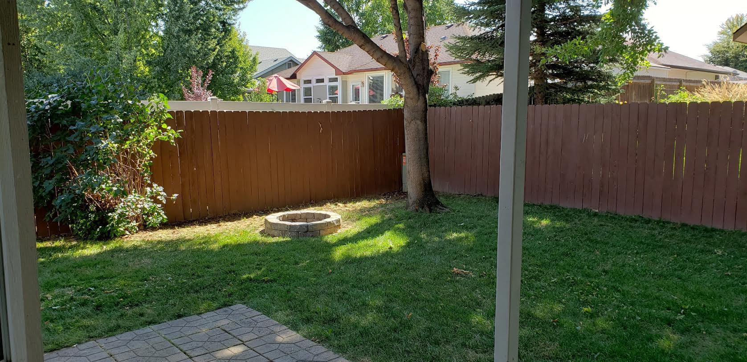
Family Fun Time

