Slide 1






PAYMENT CARD SECURITY
AND
SELF-ASSESSMENT TRAINING
Jon Knudsen- PCI Compliance MANAGER

Slide 2
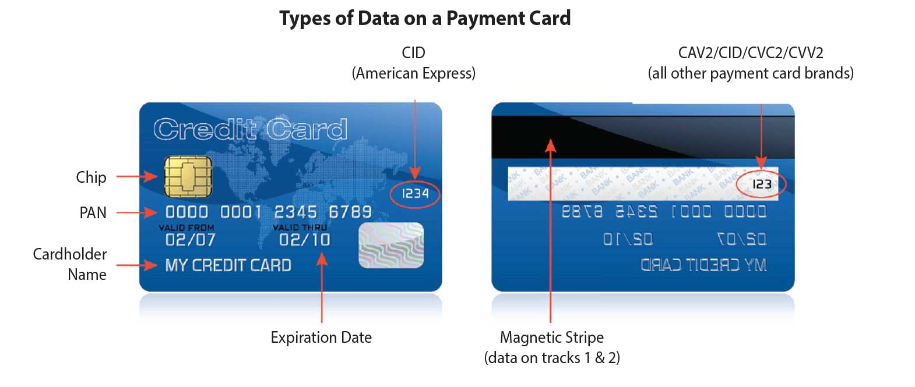
Credit Card Anatomy

Slide 3
Credit Card Anatomy
  Cardholder Data vs. Sensitive Authentication Data
  Cardholder Data (Front of Card)
  PAN (Primary Account Number)
  Cardholder Name
  Expiration Date
  Brand Logo
  EMV chip (with newer cards)
  Sensitive Authentication Data (Back of Card)
  CVC or CVV (Back of Card, except American Express)
  Full Magnetic Stripe

Slide 4
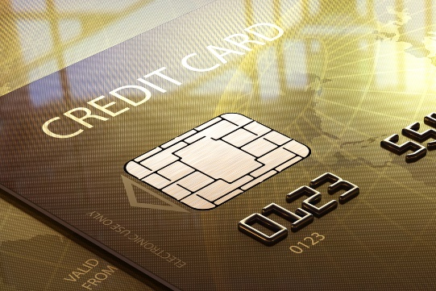
EMV Chip
EMV stands for Europay, MasterCard, and Visa
EMV chip card transactions improve security against fraud compared to magnetic stripe card transactions that rely on the holder's signature and visual inspection of the card to check for features such as hologram.
If a card is presented for payment that contains a chip, the card needs to be processed in the chip reader slot to provide the security associated with that chip.

Slide 5
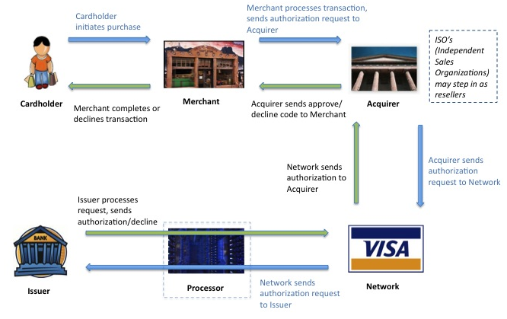
Credit Card Transaction Flow

Slide 6
PCI DSS Defined
What is PCI DSS?
Payment Card Industry Data Security Standards
A set of comprehensive requirements for enhancing payment account data security that includes:
  Security Management
  Policies
  Procedures
  Network Architecture
  Software design
  Other critical protective measurements
Learn more at www.pcisecuritystandards.org

Slide 7
PCI DSS - Defined
PCI Data Security Requirements apply to all members, merchants, and service providers that store, process, or transmit cardholder data.
  Primary goal is to protect cardholder data
  Applies to ALL payment channels
  Helps protect against fraud
  Compliance is mandatory in order for Snow College to maintain the privilege to accept/use payment cards
  Security is a layered approach that is always ongoing
  Snow College is required to provide proof of compliance annually

Slide 8
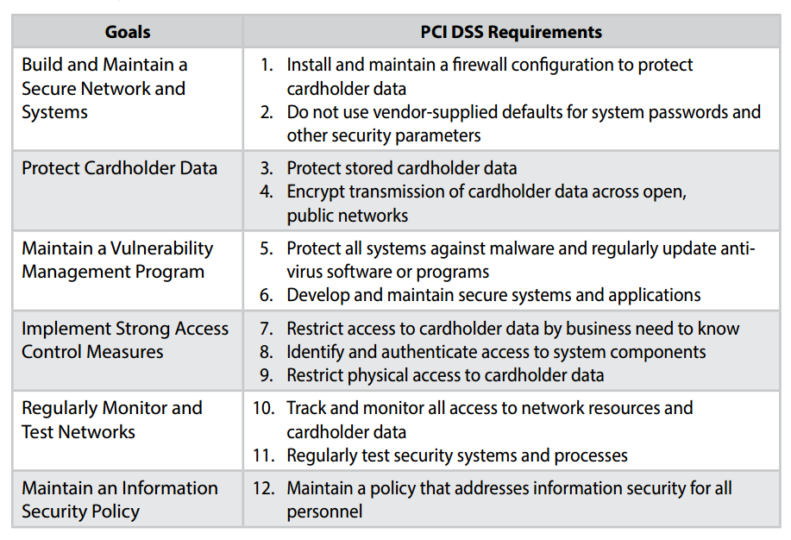
PCI DSS – Control Objectives

Slide 9
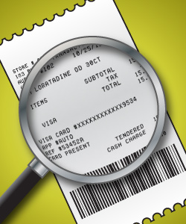
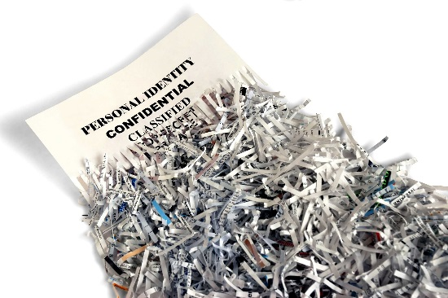
PCI DSS – Control Objectives
Protect Cardholder Data
    Do not store or keep cardholder data in either paper or electronic form
    Do not accept or send cardholder data in emails, faxes, or voicemails
    Immediately after a transaction is complete destroy any materials that may have cardholder data on it (cross cut shred etc.)
    Be sure the PAN is masked (truncated) and only shows the last four digits of the card

Slide 10
PCI DSS – Control Objectives
Implement Strong Access Control Measures
    Restrict access to cardholder data to a business only need-to-know basis
    Restrict physical access to cardholder data:
      Locked safes
      Locked files
      Destroy card information after processed – cross shredded

Slide 11
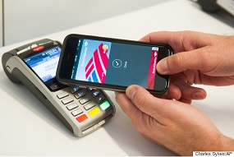
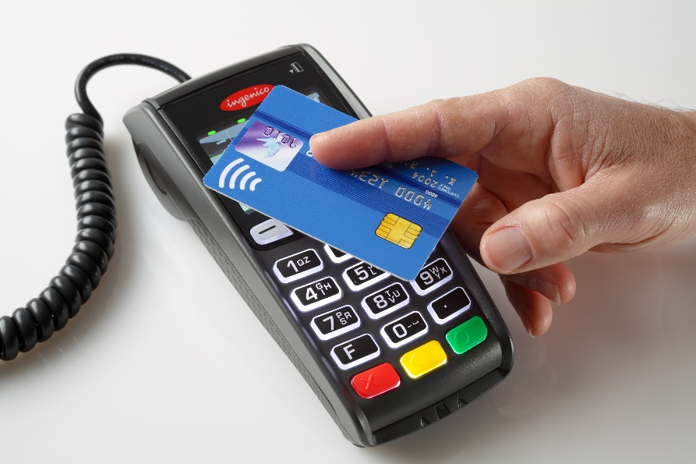
Contactless Payments
Snow College is able to accept contactless payments. Be sure the area around the credit card device is clean and there are no cell phones or other electronic devices close to the credit card device that could potentially read payment information.

Slide 12
PCI DSS - Mandatory
PCI Compliance is mandatory to accept payment cards.
  Risks:
    Large monetary fines assessed to your department and/or Snow College
    Loss of merchant status for department
    Loss of merchant status for Snow College
    Loss of faith in Snow College brand name
  Benefits:
    Helps protect against fraud
    Keeps you and Snow College out of the headlines
    Allows you to continue accepting credit cards
    Upholds Snow College brand name

Slide 13
PCI DSS – Protect Data
Easiest way to comply:
  DON’T KEEP CARDHOLDER DATA!!
Help organizations proactively protect customer account data
    Keep data secure and confidential
    Restrict/limit access to card data
    Examples:
    Find and eliminate prohibited data
    Do not keep what you do not need
    Frequently review your processes

Slide 14
Approved Credit Card Methods
Snow College businesses are allowed to accept credit card payments through the following methods:
Face-to-Face transactions at Point-of-Sale (POS) terminal
Over-the-Phone transactions
  Cashier enter the transaction in a POS device with customer on the phone
  Ask the customer to repeat the credit card number to verify it is correct
  Website transactions conducted by customer
  Website transactions conducted by Snow College Employee
    Machine must meet the POS terminal requirements
  Paper form coming into Snow College business environment
    Must be processed within one business day
    Follow form application requirements – credit card information at bottom of form
    Bottom of form must be cross-shredded once credit card is processed
    Anyone who has access to forms must participate in Snow College’s Payment Card Security Training

Slide 15
Cashier Procedures
A cashier is defined as anyone who has access to or processes credit card data
Required to have unique log in for operating POS device
Keep log in credentials confidential and does not share with others
Keep credit card environment secure from non-cashier personnel
Log off when stepping away from machine
Log off another cashier and log in with own credentials when processing transaction
Turn off POS device at night and store in a secure area
Hand credit card back to customer with receipt after checking signature

Slide 16
Data Breach
Inspect the device daily before processing payment cards for any sign of tampering and report anything unusual immediately and do not use the device until it has been determined safe to process payments.
Contact a member of the PCI Committee immediately if:
You are aware of a breach
You suspect fraud or suspicious activity with credit cards or credit card devices
A credit card device has been tampered with in any way including the device itself, any cords or plugs, unusual stickers or overlays, or if it has been replaced with a different device
If an unauthorized person attempts to inspect, move, alter, or tamper with the device including any cords and wires that connect to the device

Slide 17
Frequently Asked Questions?
How long do we need to retain credit card transaction data?
  Complete cardholder data should not be held for any longer that it takes to process and confirm the transaction.
  Credit card receipts and reports that do not show complete PAN can be maintained securely for business purposes based on Merchant need. Holding full cardholder data for longer than 3 months from date of transaction is not necessary.
What is appropriate physical security for our credit card devices?
  Devices should be located in an area that can be physically secured during non-business office hours. If the office area can be locked this is very helpful. Terminals located in common or open areas may need to be unplugged and locked in a secure area at the end of the business day.
What is appropriate segregation of duties?
  Duties should be segregated as per your cash handling policy and procedures.
If a customer requests and gives us permission to hold their credit card information for future transactions is that o.k.?
  We can not honor this request, as we can not hold the data. Areas having a unique business needs such as recurring gifts, etc. can accomplish this using a third party vendors, such as Nelnet. Contact me, Jon.Knudsen@snow.edu to discuss situations that need clarification.

Slide 18
NEXT STEPS…
Contact me at jon.knudsen@snow.edu for questions on assessment or schedule an onsite visit.
Work with Jon Knudsen to remediate any operation process related to security of credit card data.
Any employee with access to credit card devices must have proper training BEFORE processing any transactions.
Complete the Payment Card Security Quiz and return it to your supervisor.
Sign the Payment Card Security and Confidentiality Agreement and return it to your supervisor.

Slide 19
Question and Feedback
Need help or have questions regarding PCI DSS please contact me at jon.knudsen@snow.edu.
I am happy to assist!

