Slide 1
Submitting an ePAF
FT OVERLOAD/ADJUCT/Coach

Slide 2
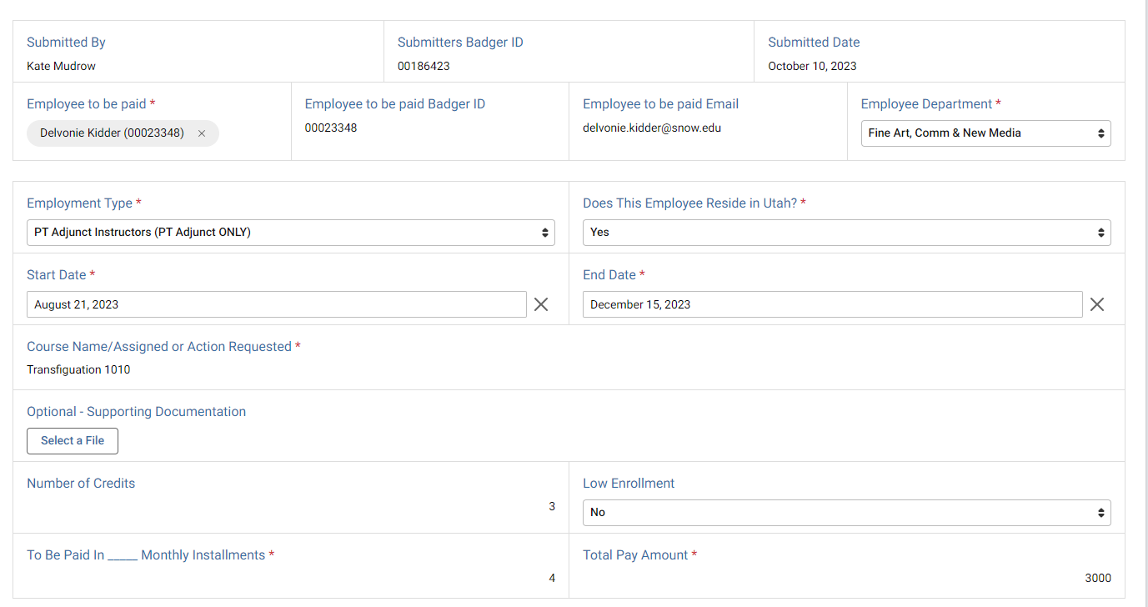
Initial Submission
Employee to be paid information. Type their name or Badger ID and select them. ID and email auto fill. Select their department
Make sure the employee you are submitting for is correct with Badger ID and Snow domain email (not students@snow.edu)
Select correct employee type. Adjuncts and Coaches are required to sign Memorandum of Understanding (MOU) for EVERY ePAF submitted for them. FT Overload are not required to sign MOUs
*You cannot submit an ePAF for yourself. Either the supervisor or other designated person must submit on your behalf.

Slide 3
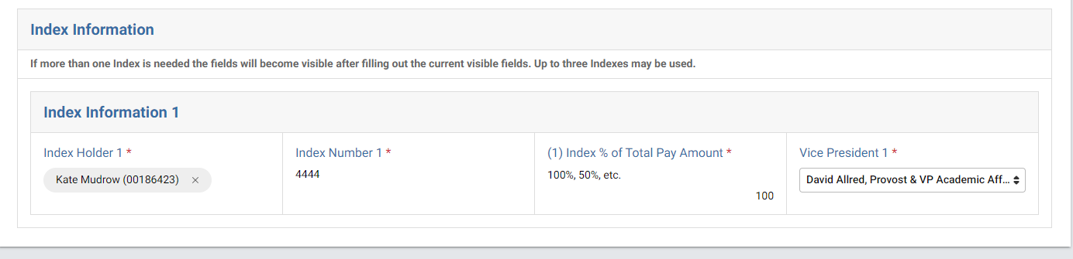
Index Information (One Index)
Make sure that this is the correct budget holder with their correct Badger ID#
If only one index will be used, put 100
Select VP of budget holder from dropdown

Slide 4
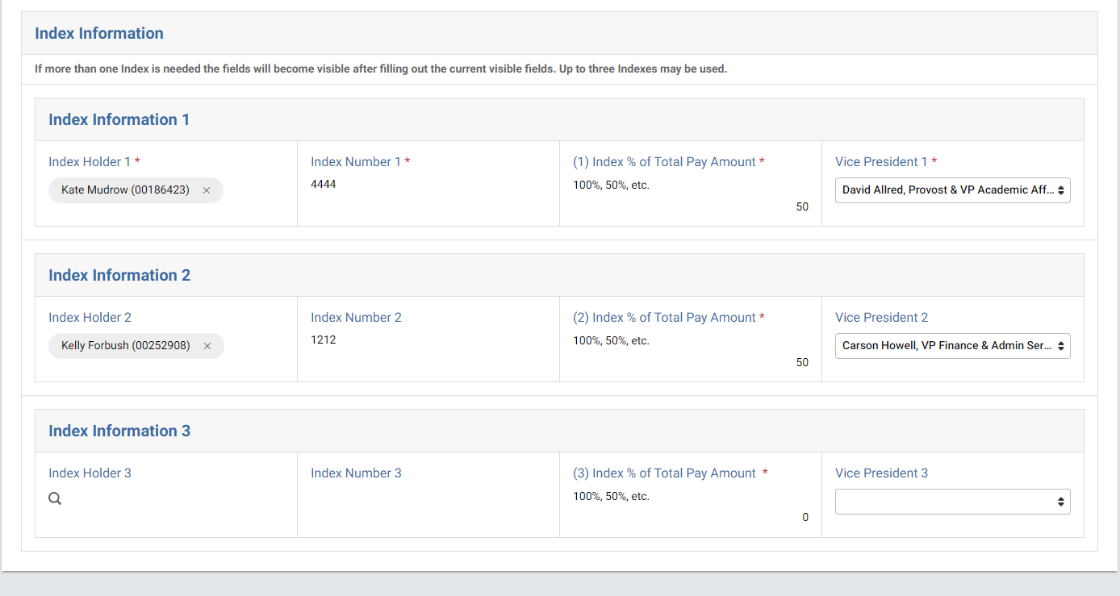
Index Information (Multiple Indexes)
If paying from multiple indexes, put % amount in Index 1 and the options for a 2nd and 3rd index will be visible
Make sure budget holder is correct with name and Badger ID
Select VP of second budget holder
If 3rd index not needed, put 0

Slide 5
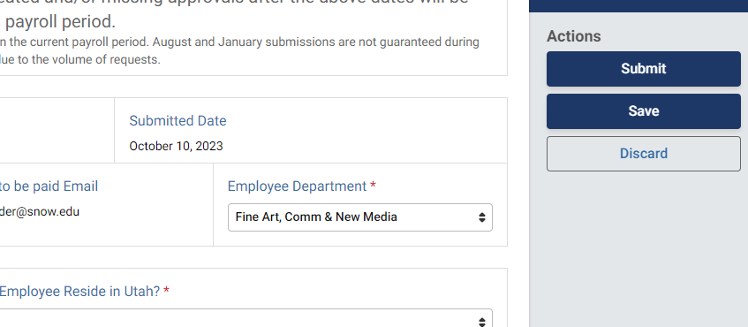
Submit : This initiates the ePAF into the workflow for signatures and approvals
Save : This saves the ePAF as a draft that can be found on Kuali Dashboard
Discard : This deletes everything without any initiation.

Slide 6
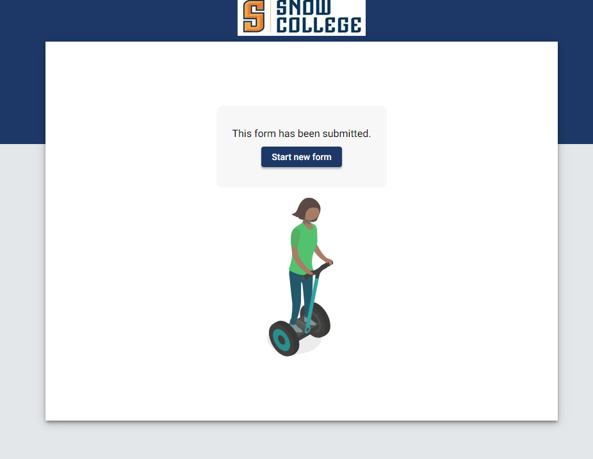
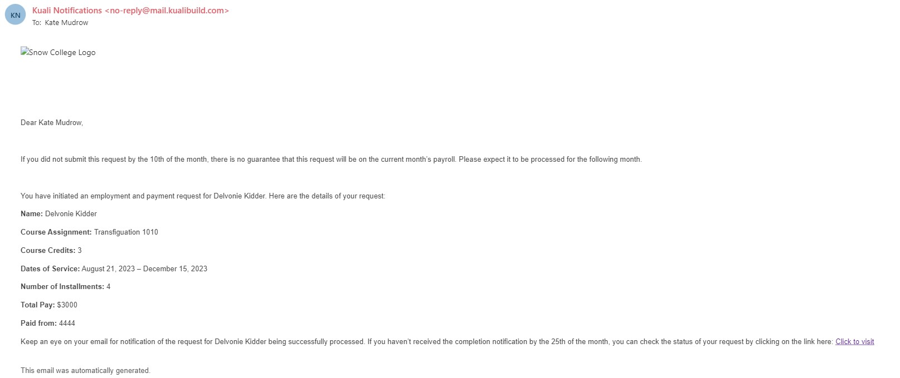
After Submission
Confirmation Screen
Confirmation Email

Slide 7
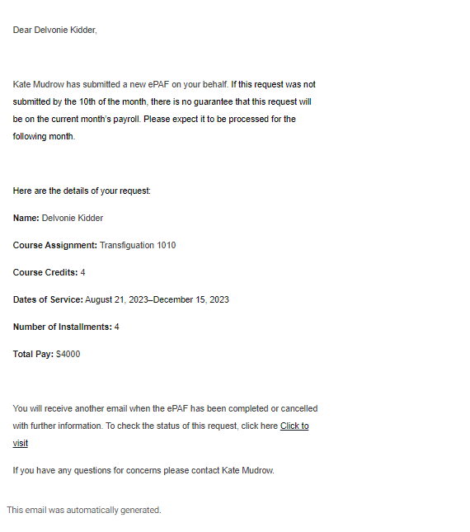
Employee to be Paid view
Confirmation Email.
All Employees to be paid will receive email confirmation to Snow Email address

Slide 8
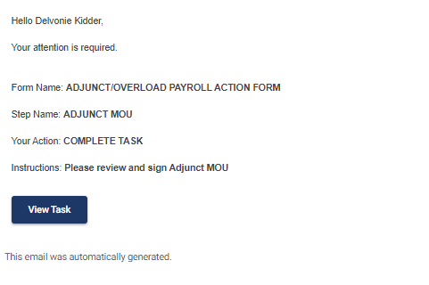
Adjuncts/Coaches View
Adjuncts and Coaches will receive a second email from Kuali with the task to sign the MOU
Follow link to complete task

Slide 9
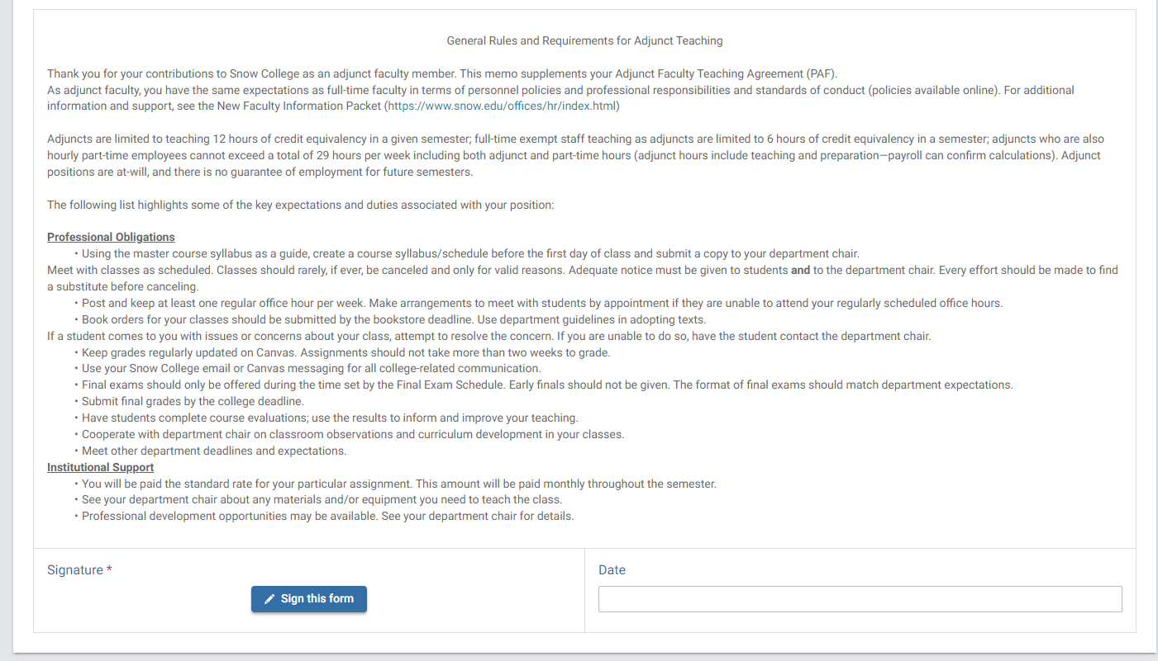
Adjunct/Coach MOU
Here to type or draw signature
*Adjunct MOU picture. Coach MOU is different but follows same steps

Slide 10
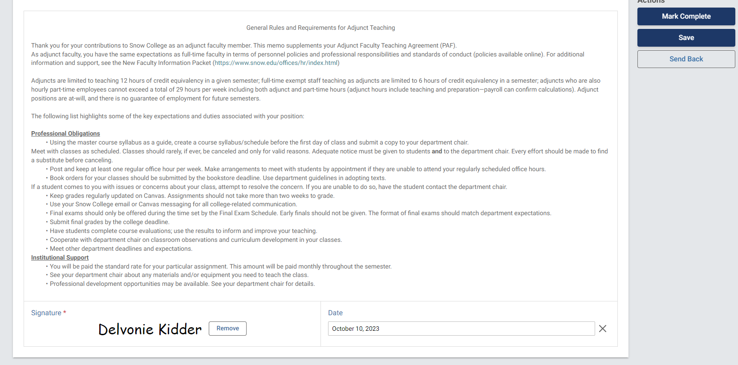
Adjunct/Coach Submitting
Click “MARK COMPLETE” to continue routing the ePAF through the workflow
Selecting “Send Back” will send it back to the submitter, restarting the workflow

Slide 11
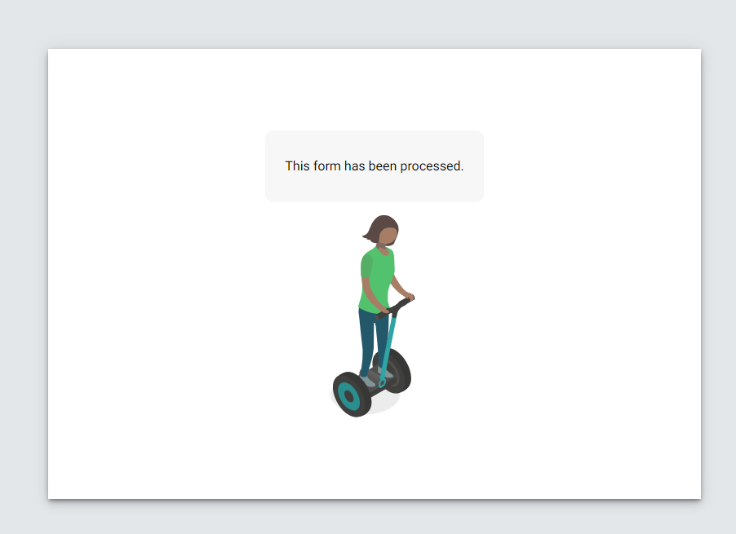
Confirmation
This form has been successfully processed.
It is now routing for administrative approvals

Slide 12
Administration Process
CPO Approval
Index/Budget Holder Approval
Index/Budget Holder - VP Approval
Budget Office Approval
HR Office Processing
Present Approval
Initial approval after submission for FT Overload or after MOU is signed by Adjunct/Coaches
Approval routed to President if total amount to be paid is greater than $12,500
Processing into Banner for Payroll
All approvals have ability to approve, deny, or send back ePAFs a necessary

Slide 13
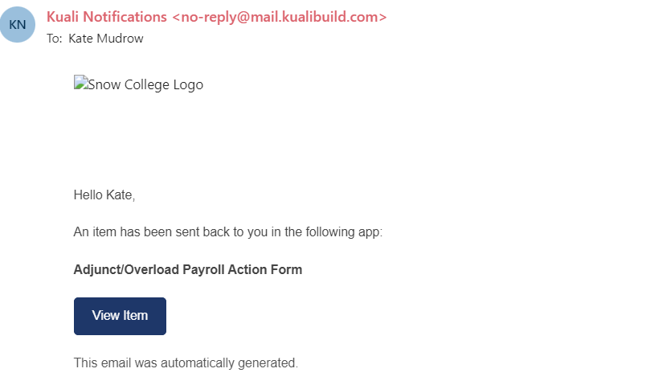
Approval Notification
Budget approver will get notice in email when time to approve

Slide 14
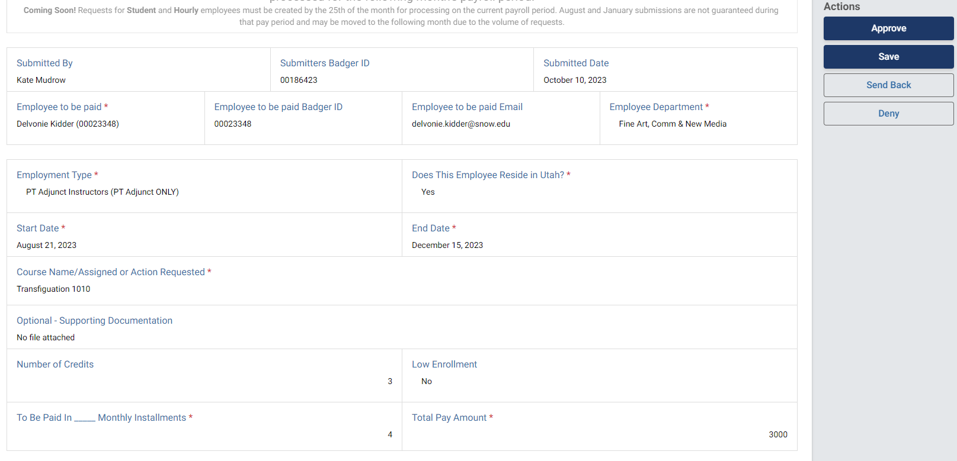
Approval/Deny/Send Back

Slide 15
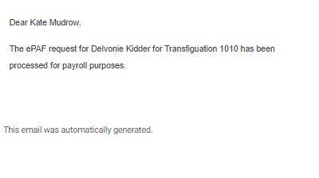
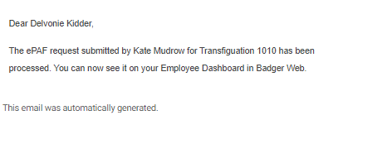
Approved - Completed
Once an ePAF has been fully approved and HR has processed, notices are sent to the submitter and the employee to be paid.
No further action needs to be taken
Submitter notice
Employee notice

Slide 16
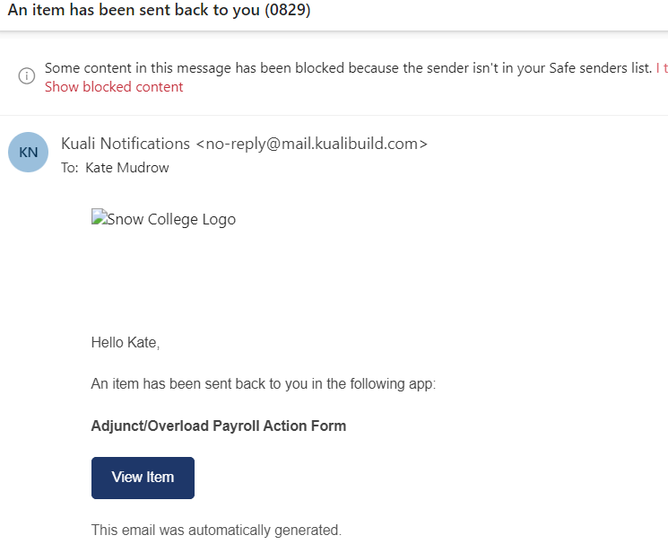
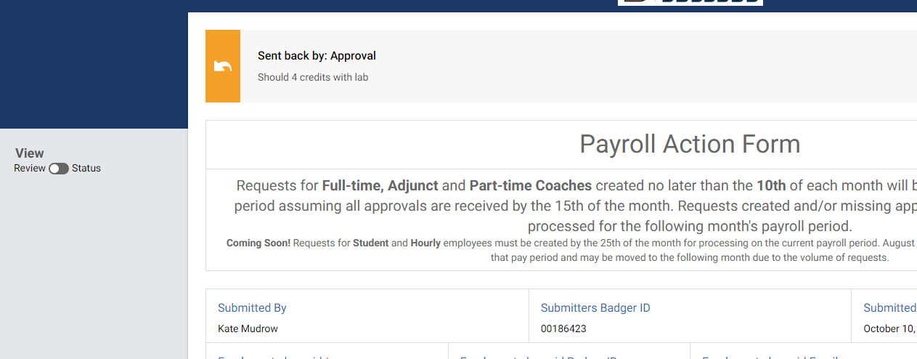
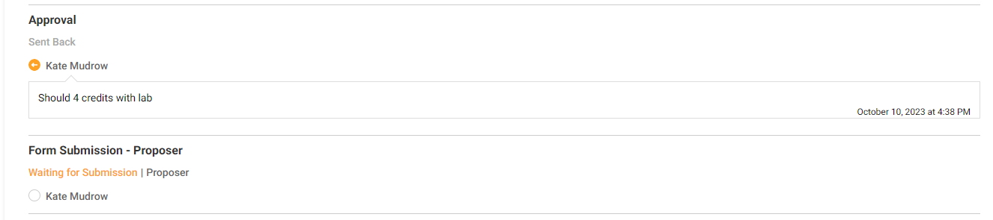
Send Back to Submitter
If adjustments must be made to ePAF, it will be sent back to the submitter
Comments of adjustment will be listed at the top of ePAF or on the review/status switch
Notice of item sent back

Slide 17
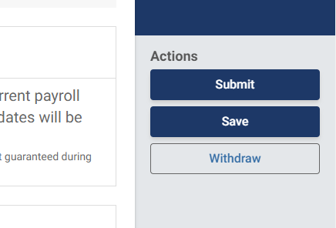
Once the adjustment is made, the ePAF will be resubmitted and the workflow will start over from the beginning, meaning it will cycle through approvals again.
The submitter also has the option to withdraw the ePAF for reasons such as the ePAF being a duplicate.

Slide 18

Status updates
The status of the ePAF can be reviewed at any time by the submitter on their Kuali Dashboard
Complete – ePAF has been processed
In Progress – Waiting on action to be taken
Denied – Was denied
Withdrawn – Withdrawn by submitter

Slide 19
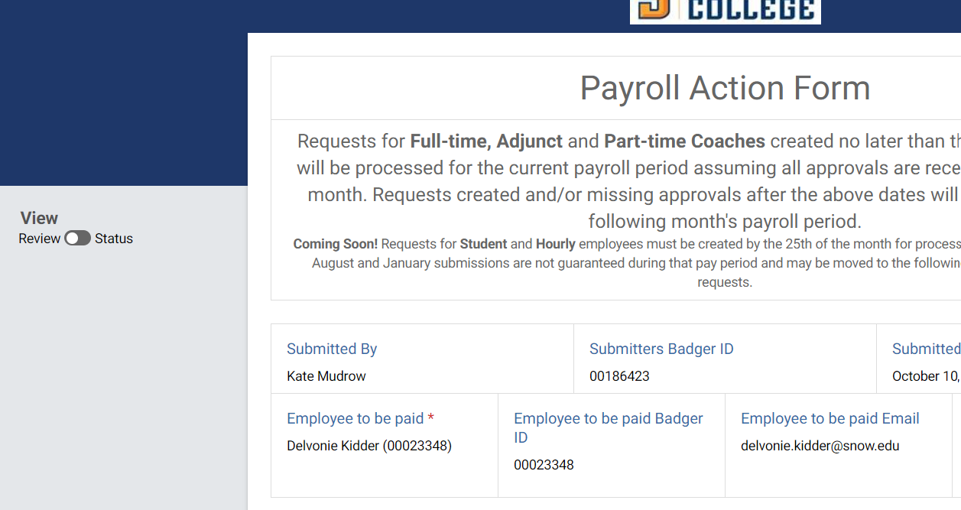
Status updates
Selecting the ePAF opens it. Switch the Review Status Bar to see where the ePAF is waiting and date/time stamps of when actions have occurred

Slide 20
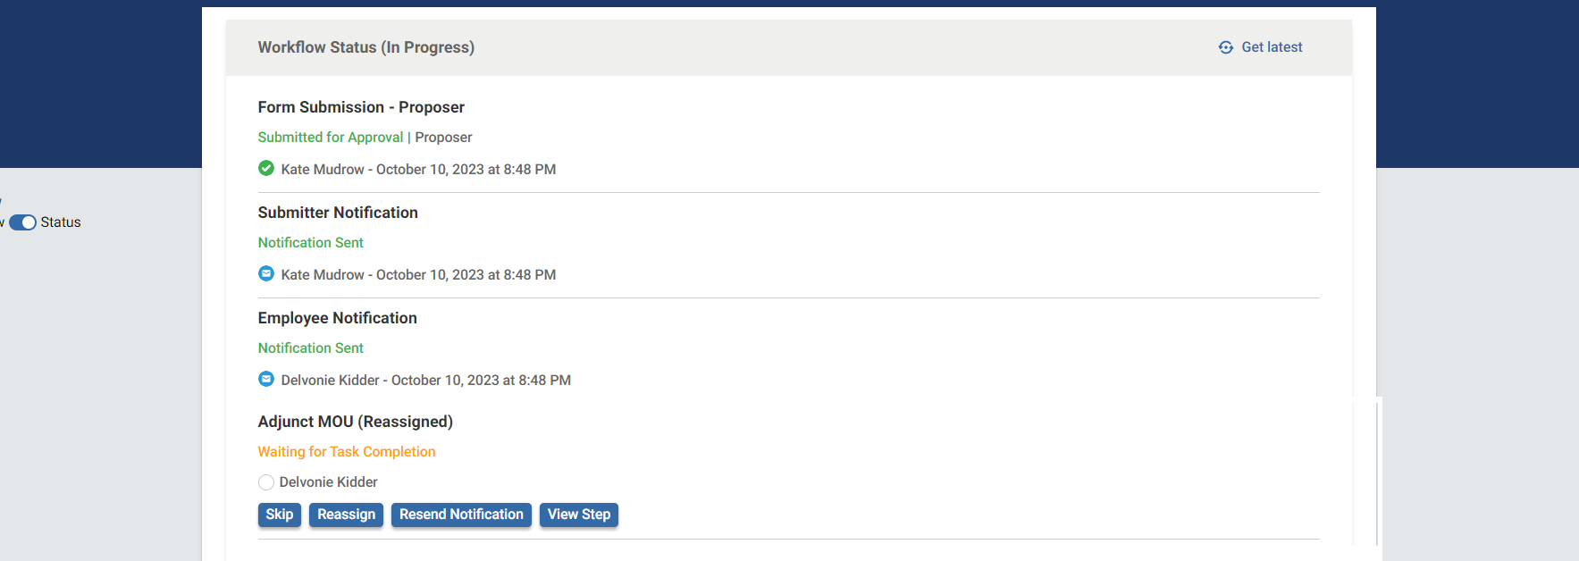
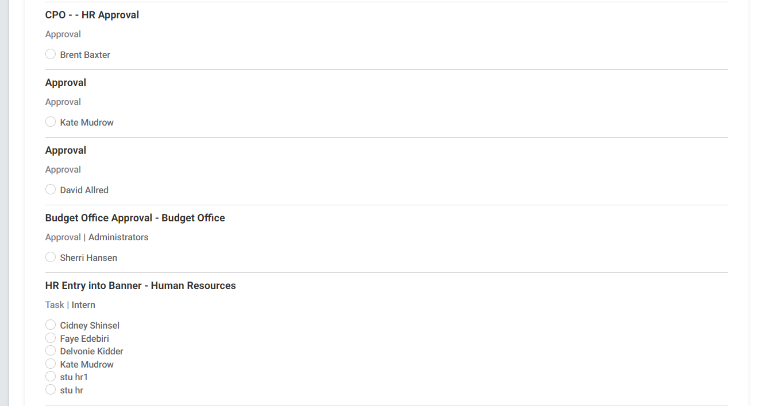
Green = Completed
Orange = Waiting to Complete
Gray = Queue for Workflow

Slide 21
Deadlines
To GUARANTEE processing for the month:
Submitted and MOU Signed by the 10th of the month
Approvals completed by 15th of the month

