Slide 1
ATTAINMENT METRICS
All metrics have two elements: all students and underrepresented students.
Underrepresented students =
  Low income (as determined by free & reduced lunch eligibility)
  Racial/Ethnic minority
METRIC: ACCESS
Resident
HS students
Within 3 years of HS graduation
METRIC: TIMELY COMPLETION
Graduation/Transfer
150% of time of entering cohort
METRIC: HIGH YIELD GRADUATES
Graduates
4 and 5-Star Jobs

Slide 2
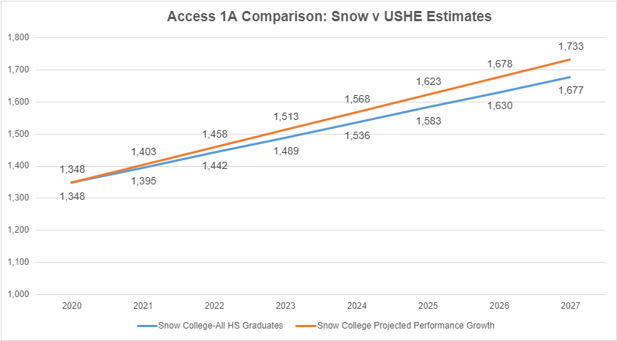
ATTAINMENT METRIC: ACCESS
ACCESS 1A: All students
USHE GOAL:
3.48% share
Adds 47 students per year to reach 1,677 HS graduates enrolled
SNOW COLLEGE GOAL: 3.60% share
Adds 55 or more students per year to reach 1,803 HS graduates enrolled

Slide 3
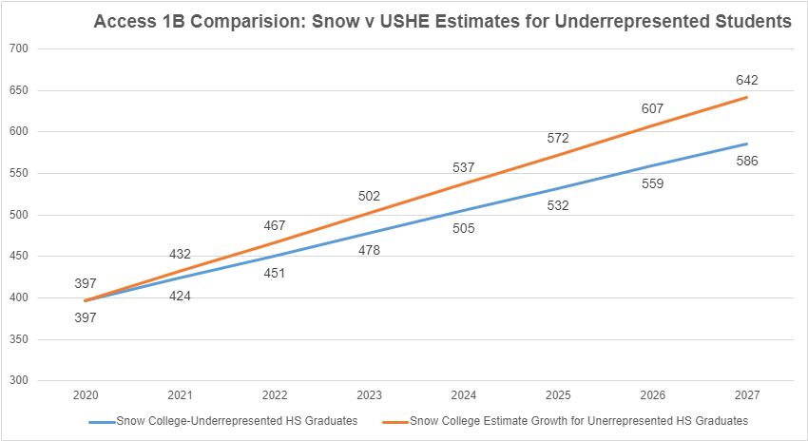
ATTAINMENT METRIC: ACCESS
ACCESS 1B: Underrepresented students
USHE GOAL:
5.77% share
Adds 27 students per year to reach 586 HS graduates enrolled
SNOW COLLEGE GOAL: 6.32% share
Adds 35 or more students per year to reach 747 HS graduates enrolled

Slide 4
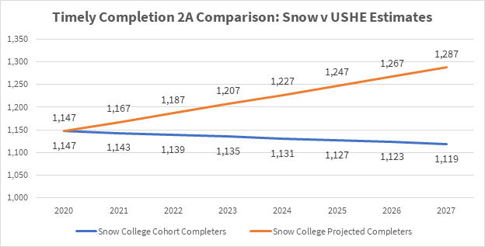
ATTAINMENT METRIC: TIMELY COMPLETION
TIMELY COMPLETION 2A: All students
USHE GOAL:
63.76% completion
Adds -4 students per year to reach 1,119 completers
SNOW COLLEGE GOAL: 73.3% completion
Adds 20 or more students per year to reach 1,287 completers

Slide 5
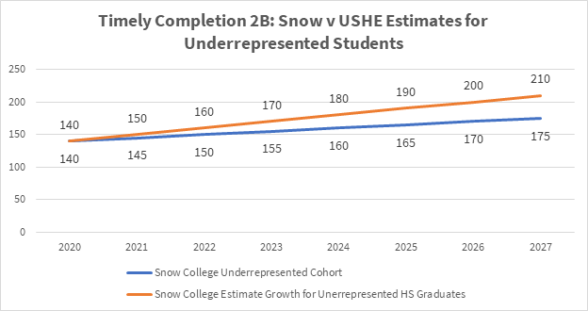
ATTAINMENT METRIC: TIMELY COMPLETION
TIMELY COMPLETION 2B: Underrepresented Students
USHE GOAL:
58.5% completion
Adds 5 students per year to reach 172 completers
SNOW COLLEGE GOAL: 70.2% completion
Adds 10 or more students per year to reach 210 completers

Slide 6
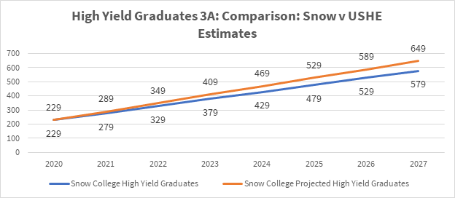
ATTAINMENT METRIC: HIGH YIELD GRADUATES
HIGH YIELD GRADUATES 3A: All students
USHE GOAL:
34% of graduates
Adds 50 graduates per year to reach 578 high yield graduates
SNOW COLLEGE GOAL: 38.0% of graduates
Adds 60 or more students to reach 649 high yield graduates

Slide 7
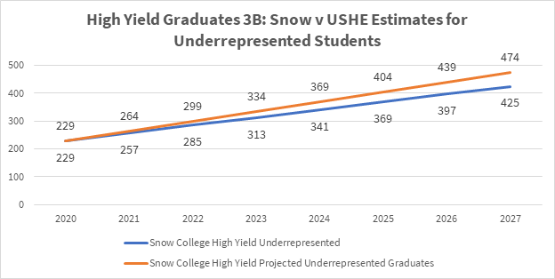
ATTAINMENT METRIC: HIGH YIELD GRADUATES
HIGH YIELD GRADUATES 3B: Underrepresented Students
USHE GOAL:
34.0% of graduates
Adds 28 students per year to reach 422 high yield graduates
SNOW COLLEGE GOAL: 38% completion
Adds 35 or more students per year to reach 474 high yield graduates

Slide 8

Questions

