Slide 1

An Introduction to SEM
Strategic Enrollment Management

Slide 2
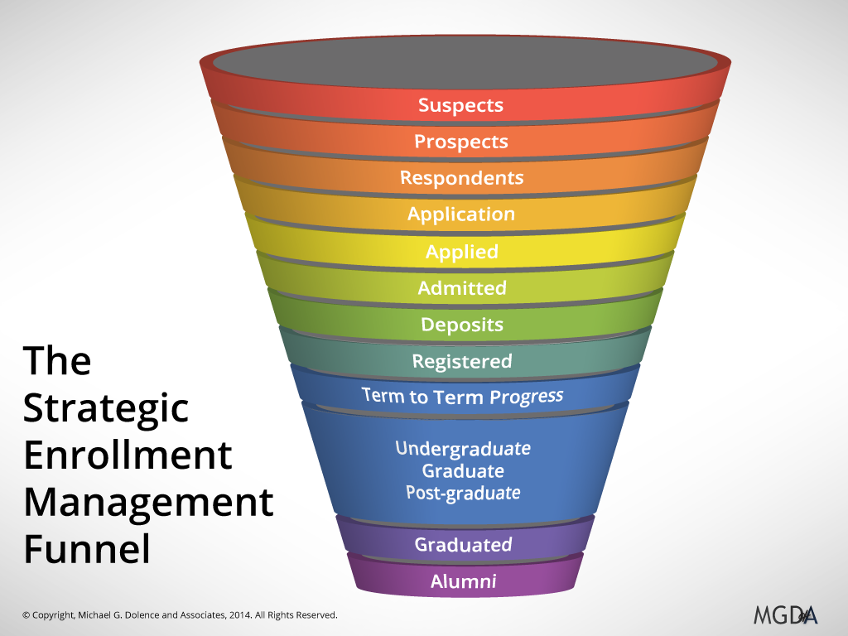
What is SEM?
Strategic Enrollment Management is defined as a coordinated set of concepts and processes that enables fulfillment of institutional mission and students’ educational goals. (Bontrager, 2008)

Slide 3
What is SEM?
Traditional Model: Admissions Office, here’s the goal, hope you can hit it!
SEM Model: Let’s look at the trends! What is our mission? How can we collaborate across campus? Do we need to modify goals?

Slide 4

Components of SEM
What type of institution are we and what impact do we have on the world around us?
What is our institutional mission and what are our priorities?
Optimal Enrollment
  Number
  Diversity
  Service area
  Student type
Bontrager and Kerlin 2004

Slide 5
Components of SEM
Student Recruitment
Financial Aid
Retention
  Academic Experience
  Class availability
  Progress towards degree
Marketing
Career Services
Academic Advising
Curriculum and Program Development
Methods of Program Delivery
Campus/Student Life
Facilities
Bontrager and Kerlin 2004

Slide 6
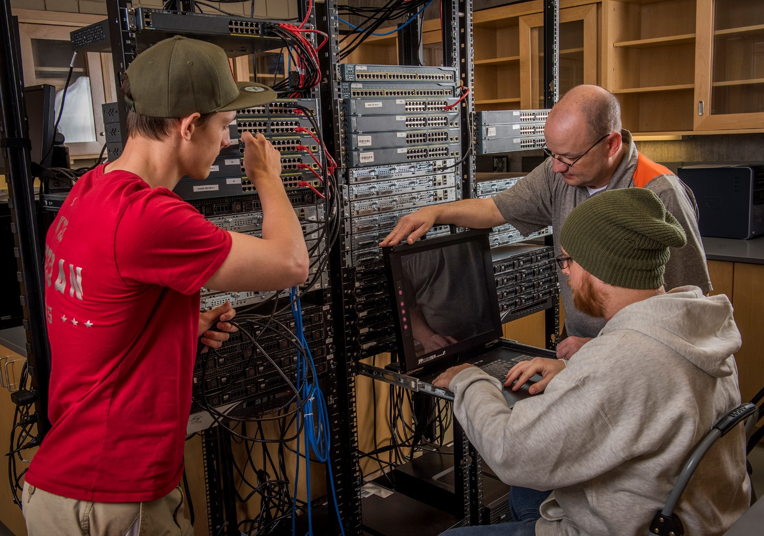
What does this mean for me?
Based on the national and state-wide trends, we are competing for fewer students.
We have to differentiate ourselves from the rest of the pack.
Academics plays a huge role in both recruitment and retention of our students.

Slide 7
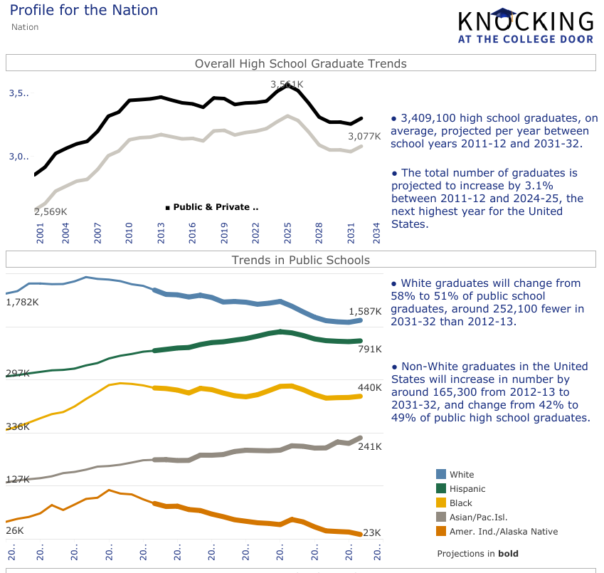
Let’s Talk Data
What do we know about the national
landscape?

Slide 8
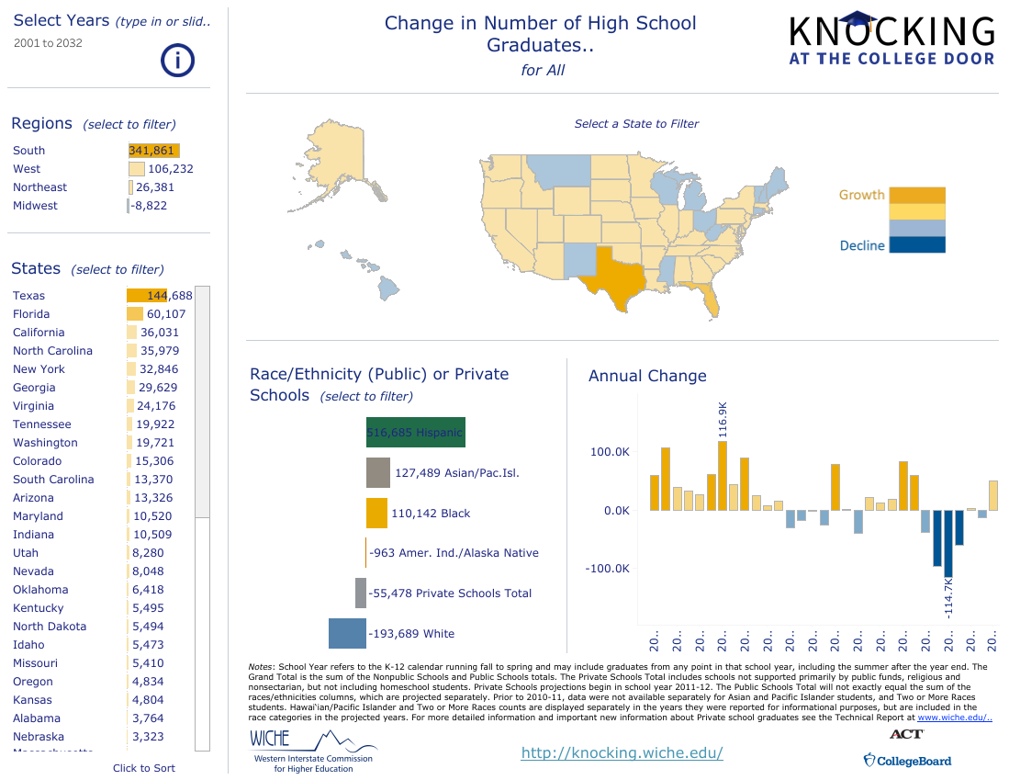

Slide 9
Let’s Talk Data
What about the Utah landscape?
https://knocking.wiche.edu/state-profiles

Slide 10
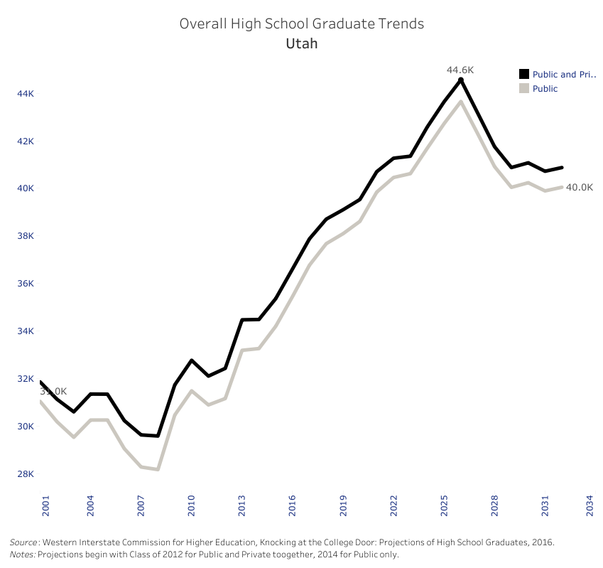

Slide 11
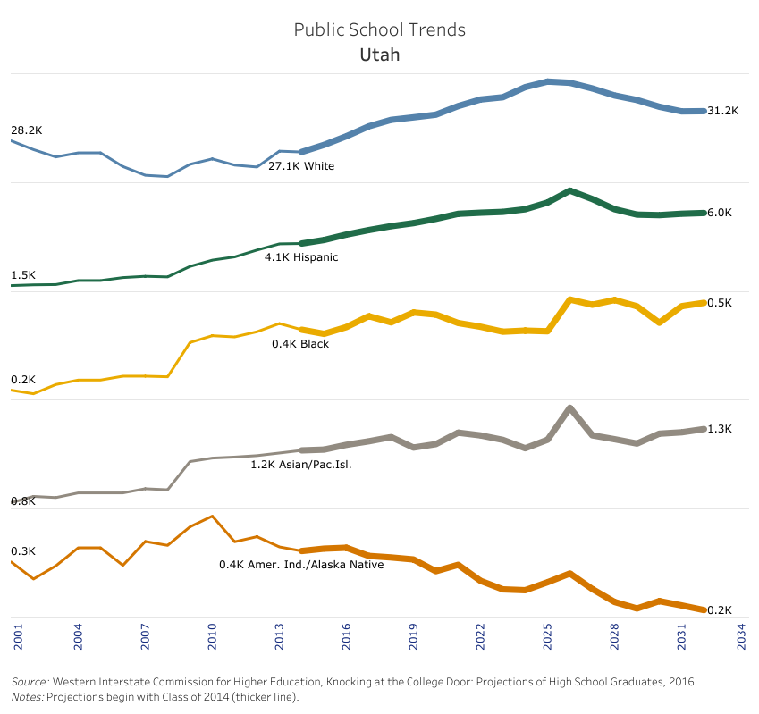

Slide 12
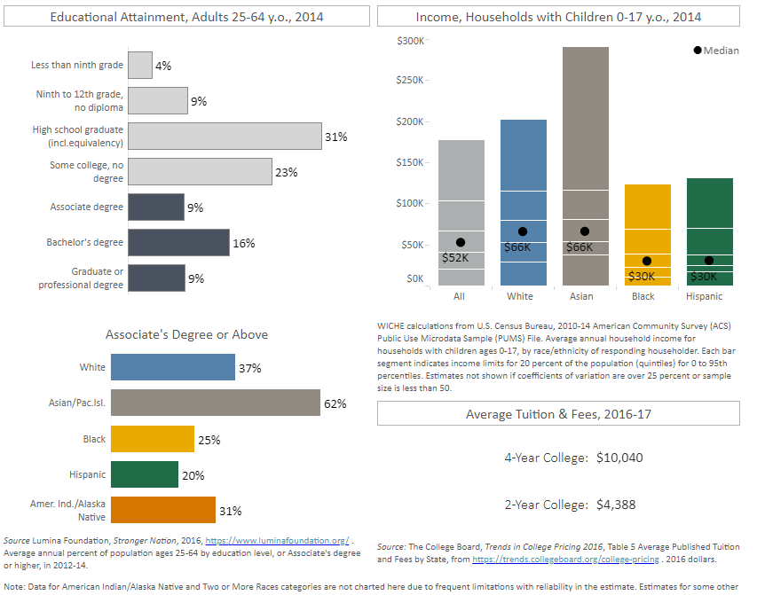
Let’s Talk Data
Do we have an opportunity here?

Slide 13
What can you do? Chances are you are already doing it!
Participate in recruitment events.
  Be present if your department is doing an event for the community or K-12 participants.
  Share what sets your subject area apart, specifically at Snow College.
Be personal in your communication.
  Whether for current or potential students…addressing them personally is key.
  Use their communication medium—Do they read emails? Use Canvas? Do you text or use social media?

Slide 14
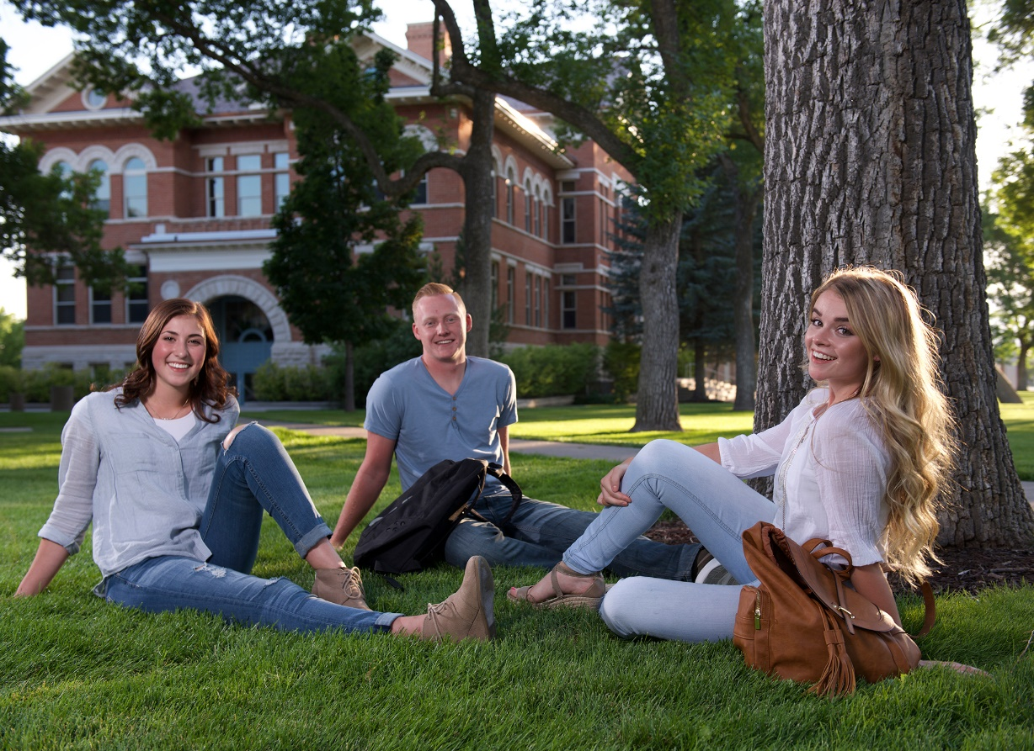
What can you do? Chances are you are already doing it!
Partner with a similar department or area when sending messages or doing events.
Utilize technology in the admissions office to maximize your efforts.
Work with the Scholarship Office to leverage scholarship dollars to recruit and enroll the students who may choose to go elsewhere.

Slide 15

What can you do? Chances are you are already doing it!
There is no recipe that works for every person, department, or institution.
Do you know your students? Do you know why they chose you? How do you capitalize on what you know?
Keep trying new things…find what works for you!

Slide 16

It’s all about collaboration!
We all have the same goal: to recruit, retain, and graduate students.
No one office can do it alone.

Slide 17
Questions?

