Slide 1
Leadership

Slide 2
Leadership is About People
“Great customer service is only delivered by nice, passionate, caring employees. There is no other way it can happen.”
“Customer service is not a department…it’s an attitude.
“NOTHING IS AS FAST AS THE SPEED OF TRUST.”
“Know the magic of PULLING TOGETHER.”
Recognition is a need we all crave, and there are no exceptions.” (Maslow)
Quotations from: You Can’t Send a Duck to Eagle School

Slide 3
Enhancing the Spirit of Snow College
Together we make a difference—Leadership and teamwork
Promoting a collaborative campus community—Strengthen communication, breaking down silos, sharing a common purpose
Strengthen professional relationships—confidence, trust, and encouragement

Slide 4
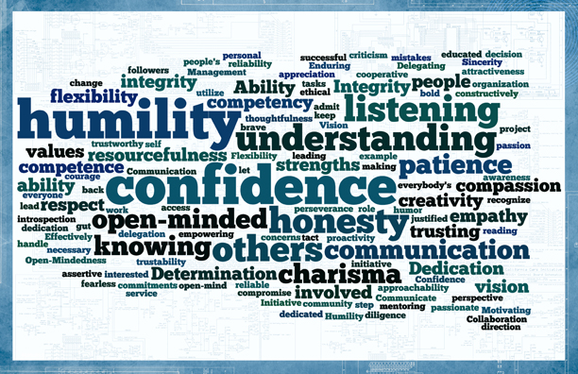

Slide 5
Situational Leadership
The relationships between
leaders and followers

Slide 6
The Goleman Theory of Situational Leadership
Daniel Goleman, the author of “Emotional Intelligence,” defines six styles within situational leadership.
Coaching leaders who work on an individual’s personal development as well as job-related skills. This style works best with people who know their limitations and are open to change.
Pacesetting leaders who set very high expectations for their followers. This style works best with self-starters who are highly motivated. The leader leads by example. This style is used sparingly since it can lead to follower burnout.
Democratic leaders who give followers a vote in almost all decisions. When used in optimal conditions, it can build flexibility and responsibility within the group. This style is, however, time consuming and is not the best style if deadlines are looming.
Affiliative leaders who put employees first. This style is used when morale is very low. The leader uses praise and helpfulness to build up the team’s confidence. This style may risk poor performance when team building is happening.
Authoritative leaders who are very good at analyzing problems and identifying challenges. This style is good in an organization that is drifting aimlessly. This leader will allow his or her followers to help figure out how to solve a problem.
Coercive leaders who tell their subordinates what to do. They have a very clear vision of the endgame and how to reach it. This style is good in disasters or if an organization requires a total overhaul.

Slide 7
Blanchard & Hersey’s Situational Leadership
Based on two concepts: leadership itself, and the developmental level of the follower.
Telling leaders (S1, specific guidance and close supervision): These leaders make decisions and communicate them to others. They create the roles and objectives and expect others to accept them. Communication is usually one way. This style is most effective in a disaster or when repetitive results are required.
Selling (S2, explaining and persuading): These leaders may create the roles and objectives for others, but they are also open to suggestions and opinions. They “sell” their ideas to others in order to gain cooperation.
Participating (S3,sharing and facilitating): These leaders leave decisions to their followers. Although they may participate in the decision-making process, the ultimate choice is left to employees.
Delegating (S4, letting others do it): These leaders are responsible for their teams, but provide minimum guidance to workers or help to solve problems. They may be asked from time to time to help with decision-making.

Slide 8
Situational leadership is not something you do TO people, but something you do WITH people.

Slide 9
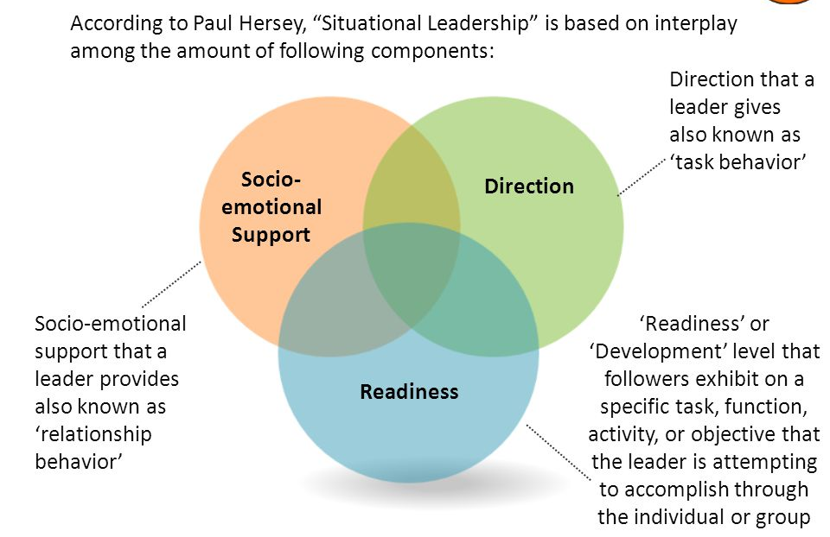
Components of Situation Leadership

Slide 10
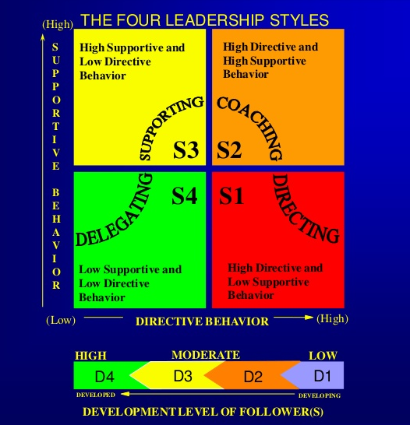

Slide 11
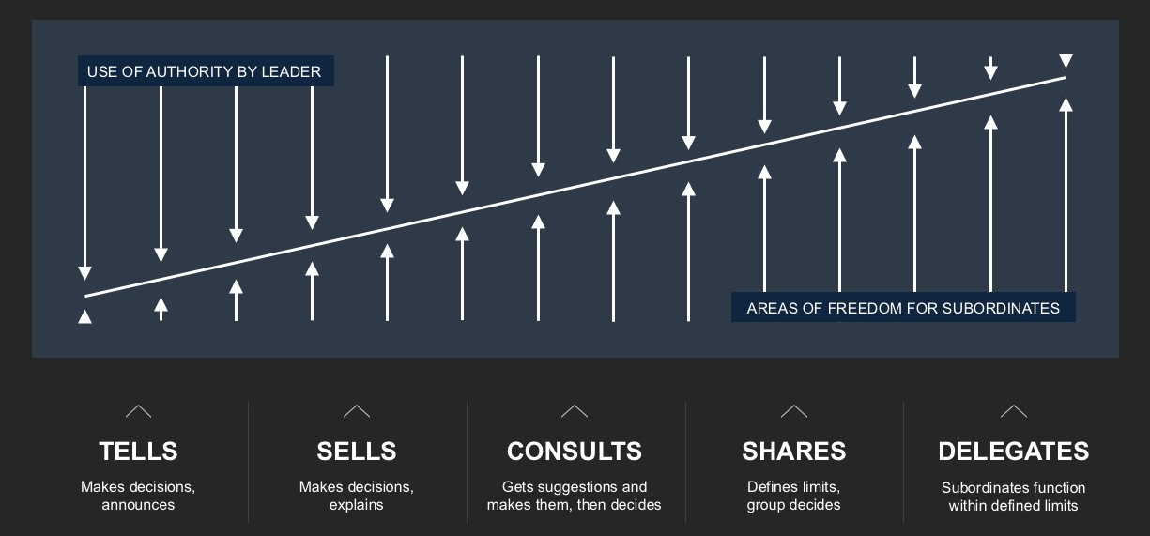
Leadership Continuum Diagram

Slide 12
John Chambers’ Video
Twenty plus years at Cisco
Positions include President and CEO and Chairman of the Board
Cisco was recognized by Fortune Magazine during his tenure as: “America’s Most Admired Company”

Slide 13
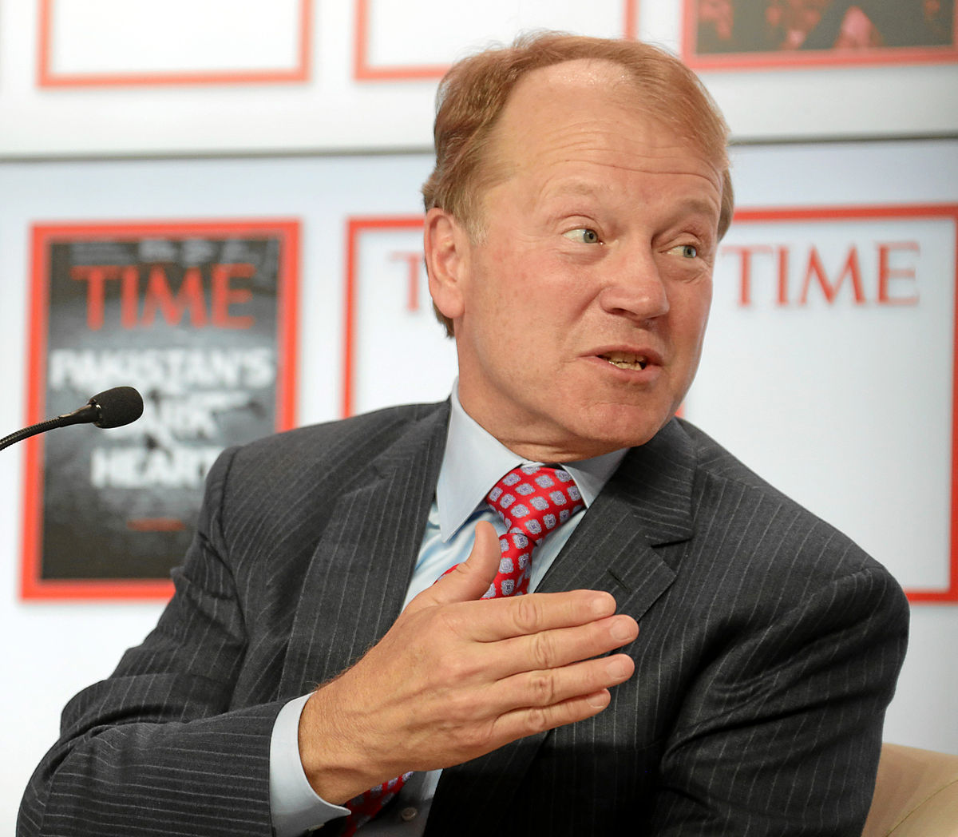
Leadership@Cisco
John Chambers
Wendy Bahr
Karen Walker
Hilton Romanski

Slide 14

Reflection
1. What are you passionate about?
2. What three leadership characteristics are most important?
3. What keeps you up at night?
4. What will Snow College look like in the future?

Slide 15

Our people make the difference!
video

Slide 16
Old Chinese Poem
From: You Can’t Take a Duck to Eagle School
GO to the people
LIVE among the people
LEARN from them.
START with what they know,
BUILD on what they have,
But of the BEST leaders,
When their TASK is done,
The PEOPLE will remark,
“WE HAVE DONE IT OURSELVES.”

Slide 17
“Nurturing yourself is not selfish—it is essential to your survival and your well being.”
Renee Peterson Trudeau

