Slide 1
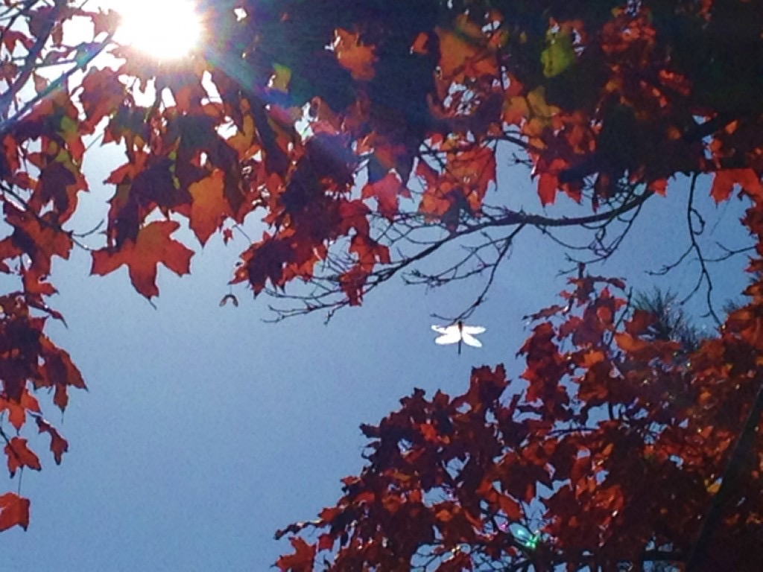
In Memoriam…
A life that touches others goes on forever…

