Slide 1

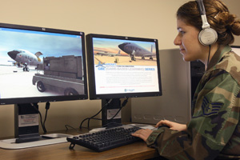
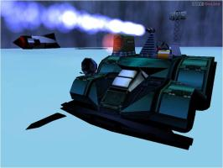
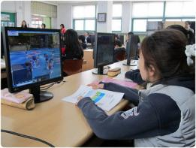
Digital Game-Based Learning in Mathematics
Active Student Learning Through Gaming & Immersive Learning Environments
Presented by: Steven Zollinger
(Southwest Research Institute, 2012)
(Cognitoy, 2000)
(Advanced Technology Korea, 2011)
Notes:
“Digital game-based learning in mathematics: Active student learning through gaming and immersive learning environments”
“Presented by: Steven Zollinger”

Slide 2

A New Age for Learning
(Meyers, 2009)
http://www.youtube.com/watch?v=Mirxkzkxuf4
Notes:
(A video by Meyers (2009) is shown which depicts the vision of learning in the 21st century. The clip can also be viewed on Youtube at http://youtu.be/Mirxkzkxuf4)

Slide 3



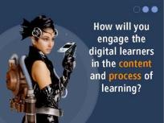

A Need for Change
Fundamentally changed learners (Prensky, 2001)
Yesterday
Today
(Ravado, 2010c)
(McCurry, 2010)
(Julian, 2012)
(Nys, 2011)
(Ravado, 2010b)
Notes:
In this new age of learning, the needs and expectations of our students (click) are fundamentally changing (Prensky, 2001). The traditional lecture and passive learning (click) of yesterday are no longer a sufficient means of holding the attention and interest of our students. They need to be (click) engaged and immersed in a learning environment that effectively harnesses the full power of modern and emerging technologies.

Slide 4



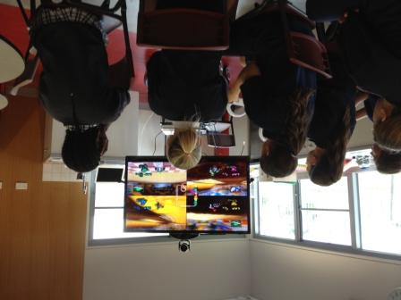
A Need for Change
Yes!!!
Old teaching tools are becoming less effective (Prensky, 2001)
Radical innovations are imperative!
(Prensky, 2001)
(Hurtsville City Library, 2013)
(Britannica Kids, 2013)
(NIST, 2013)
(Australian Teacher Magazine, 2013)
Notes:
Old teaching tools are becoming less effective at reaching today’s students (Prensky, 2001).
(click)
In order to truly immerse the students in the modern educational experience, radical innovations are imperative (Prensky, 2001). Students need to experience learning at a whole new level.
(Click)
Picture an environment where each student becomes entranced in a personalized learning experience where they control the outcome.
Is this type of immersive experience even possible? The answer is (click) … “YES! Of course it’s possible!”
But the question is “how can we bring these experiences into our classrooms?”.

Slide 5
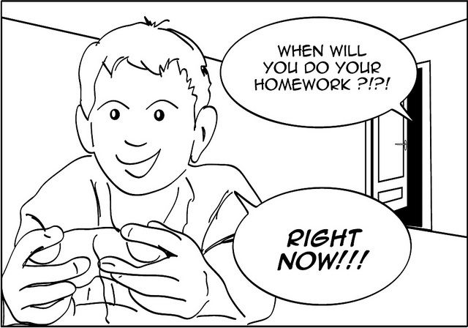
Games are the Answer!
(Le, 2011)
Notes:
Games are the answer! Can you imagine students getting home from school and rushing to do their homework because they are so excited to continue the adventures they began at school?! This is the future of education!

Slide 6
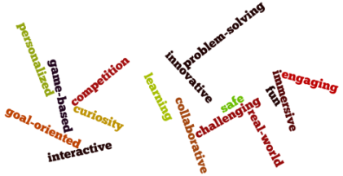
Transforming Education With GBL
Game-based learning (GBL):
  Teaching and learning strategies which utilize commercial, educational, and simulation games to engage learners and to achieve specific learning outcomes.
Games are fundamentally about learning
(Bouchard, 2011)
Notes:
The education industry would be wise to harness the power of gaming to engage, enlighten, and excite students.
(Click) Game-based learning is the key to transforming education in this way.
Game-based learning is centered around the utilization of commercial, educational, and simulation games in order to engage learners and to achieve specific learning outcomes. To effectively implement game-based learning, we must understand that games, in general,
(click) are fundamentally about learning (Bouchard, 2011). Typically, the gamers dedicate their efforts to learn about the virtual world, rules, and interactions inherent with the given game. However, if educators can design equally engaging virtual worlds where the rules and interactions require the use of important content knowledge to solve real-world problems, the classroom will be forever changed as will the students’ views of education.

Slide 7

Transforming Education With GBL
Gaming is an EXCELLENT tool for engaging learners.
GBL must address key concerns for success.
Plan for our successful implementation of GBL.
(Martin, 2010)
Notes:
In the following slides, I will describe (click) why gaming is such an excellent tool for active engagement in the classroom, (click) what key concerns must be addressed for effective implementation of GBL, (click) and how our implementation of GBL will be most successfully executed.

Slide 8
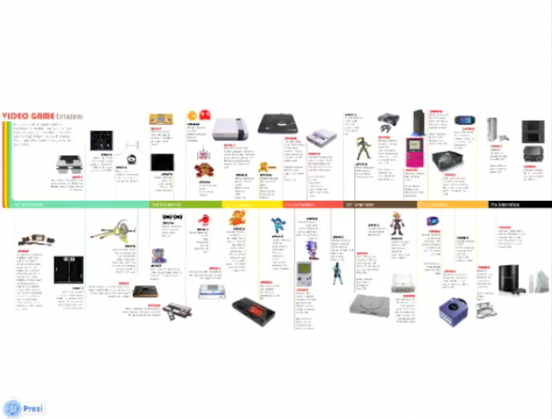
History of Video Games
(Online Education, 2012)
http://prezi.com/eqz3dyfmxts-/copy-of-the-history-of-video-games/?kw=view-eqz3dyfmxts-&rc=ref-29936595
Notes:
From very humble beginnings, inspired innovators have designed games which were truly magical as they transported the gamer into worlds filled with imagination and wonder. In the 1970s and 1980s, the first of these games appeared on gaming systems by companies like Atari, Nintendo, and Sega. Popular arcade games like Pac-Man, Donkey Kong, and Space Invaders captivated global audiences. As technology advanced, these systems were updated or replaced with even more powerful systems which in turn gave birth to gaming icons like Mario, Sonic the Hedgehog, and Link.
Then handheld gaming systems further revolutionized the gaming experience by adding portability. In more recent years gaming systems have even been incorporating motion sensitive interfaces to further engage players in incredible virtual worlds. Today the possibilities for harnessing the power of these games are truly endless.

Slide 9
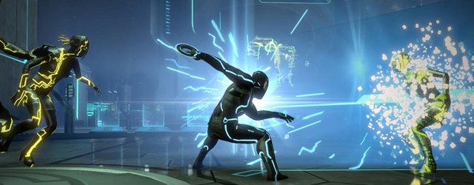
Gaming has Reached Critical Mass
Critical Mass
The moment when an innovation has been adopted by enough individuals so that further adoption is self-sustaining.
(Rogers, 2003)
(Critical Mass Interactive, 2011)
Notes:
As video games and the requisite technology have advanced, their sales and use have been growing exponentially for the past decade. In fact gaming has reached critical mass in our global society. According to Rogers (2003), this means that the innovation has been adopted by enough individuals so that further adoption is self-sustaining.

Slide 10
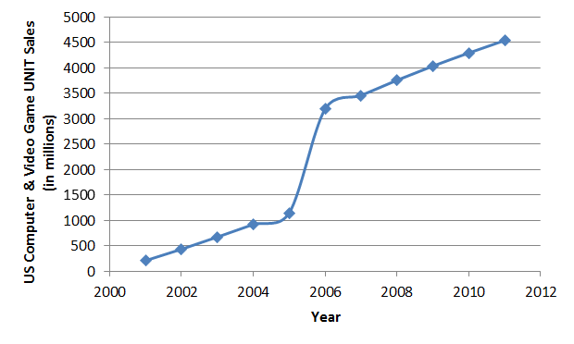
Gaming has Reached Critical Mass
Over the past 11 years, unit game sales have increased by 1700%
(from 250 million in 2001 to 4.5 billion in 2012)
(Entertainment Software Association, 2012)
Notes:
According to the Entertainment Software Association (2012), unit game sales have increased by 1700% over the past 11 years, reaching an astounding 4.5 billion units sold in 2012.

Slide 11
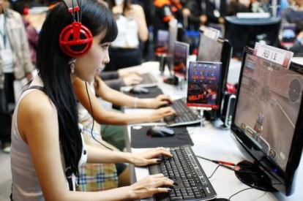
Gaming has Reached Critical Mass
67% of U.S. households played video games
The average gamer spent 8 hours per week playing video games
40% of all gamers were females
(Gaudiosi, 2011)
(Entertainment Software Rating Board, 2010)
Notes:
Furthermore, according to the Entertainment Software Rating Board (2010), (click) 67 percent of U.S. households were playing video games in 2010. In addition (click) the average gamers were devoting about 8 hours each week to playing video games, and although many believe the gaming market mainly attracts male gamers, statistics show that (click) 40 percent of the all gamers in 2010 were females. In the two years since these statistics were calculated, these numbers are likely to have increased substantially.

Slide 12

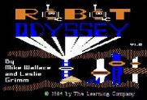
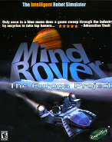

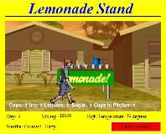
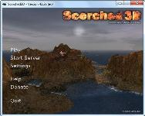
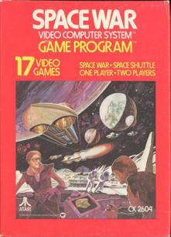



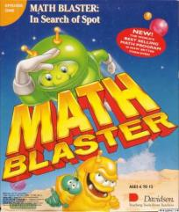
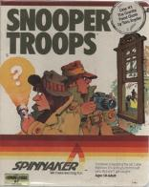
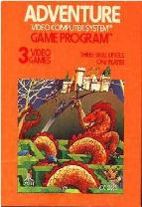

Rise of Educational Gaming
Notes:
Educational gaming has been on the crest of the gaming industry from the beginning. The key innovators were the game designers themselves who had a vision of a new world where education and entertainment were one and the same. Some of the first among these inspired innovators included Steve Russell and a group of MIT students who developed one of the first war games known in the early 1960s as Space Wars. Though an ingenious breakthrough at the time, these early game designers were very limited by the available technology. Most of these early games ran exclusively on university mainframes and had very limited availability to the public. Other war games like Scorched Earth and its successor Scorched 3D were later developed using much more advanced technology which made them readily accessible. These war games inspired computer simulations which would revolutionize training in the armed services and in industries throughout the world. Microsoft’s Flight Simulator 1.0 hit commercial shelves in 1982 and has since brought the intricacies and exhilaration of flight to front doors of gamers all over the world. Other simulations like Lemonade Stand and SimCity were also developed to teach gamers the subtleties of economics, commerce, management, and resource allocation. In the world of computer engineering and programming, games were developed to teach logic and programming skills by soldering circuits in virtual robots in the Learning Company’s Robot Odyssey and by wiring robotic cars in Cognitoy’s MindRover. Educational games would also enter in to engage students with history, reading, math, criminology, and creative problem solving.
Though many of these games were designed for entertainment purposes only and then repurposed for educational settings, many of these games were designed specifically for educational applications to help the gamers achieve desired learning outcomes and content knowledge. With the emerging technologies of the 21st century at our disposal, these games are now widely available and affordable with virtually unlimited potential for integration into the classroom.

Slide 13
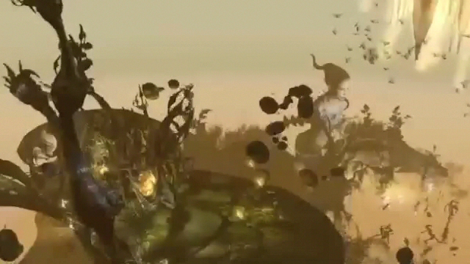
GBL Benefits at the Micro, Macro, & Mega levels
(Second Life, 2012)
http://secondlife.com/whatis/?lang=en-US
Notes:
Immersive gaming environments like the one shown in the following clip open the minds of students to worlds of breathtaking action and intense adventure and fully engage them in dynamic learning experiences (Second Life, 2012).
(A video by Second Life (2012) will be played to shows some of the amazing virtual worlds that can be created to house a game-based learning curriculum)

Slide 14
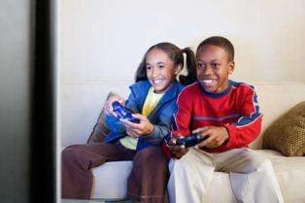
GBL Benefits at the Micro, Macro, & Mega Levels
Motivation & Engagement (Ke, 2008b)
Fun & Enjoyment (Prensky, 2001)
Challenge & Difficulty (Vogel, 2006)
Discovery & Exploration Encouraged (Whitton, 2012)
Personalized Learning (Bouchard, 2011)
Learning From Failure (Whitton, 2012)
Goal-Oriented (Chen, Liao, Cheng, Yeh, & Chan, 2012)
(Socialphy, 2012)
Notes:
In immersive gaming environments like the one depicted in the previous clip. obvious benefits include the potential of the gaming interface to motivate and actively engage students in the learning. Once this engagement is achieved, students can tackle increasingly challenging problems successfully. Students will also be encouraged to explore their surroundings and to find personalized and creative solutions to the problems they encounter. Their ultimate success stems from embracing failure as an opportunity to learn and to achieve goals.

Slide 15
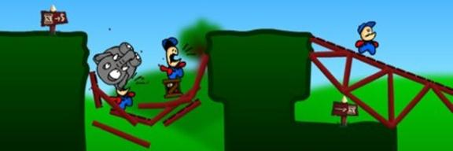
GBL Benefits at the Micro, Macro, & Mega Levels
(Limex Games, 2010)
Interactivity & Collaboration (Tang, Hanneghan, & Rhalibi, 2009)
Competition (Sigurdardottir, 2012)
Problem Solving (Prensky, 2001; Spires, Rowe, Mott, & Lester, 2011)
Real-World Context (Brom, Sisler, & Slavik, 2010)
Safe Environment (Whitton, 2012)
Notes:
Additional attributes of game-based learning that strongly appeal to many educators include a plethora of opportunities for collaboration, competition, and creative problem solving. Then to top it all off, the games allow students to experience real-world environments with interactions that are meaningful, instructive, and safe.

Slide 16

GBL Concerns
(Whole Artist Studio, 2011)
Game Choice is Crucial (Dede, 2012)
Balance Gameplay and Learning (Prensky, 2001)
Dynamic Curriculum Planning (Bouchard, 2011)
Class Organization (Groff, Howells, & Cranmer, 2010)
Support & Resources (Brom, Sisler, & Slavik, 2010)
Gaming Ability (Tsai, Yu, & Hsiao, 2012)
Notes:
However, many factors and concerns must be adequately addressed in order to build a game-based educational program that is effective, efficient, and engaging. First we must realize that all games are not created equal. The choice of which games and gaming environments to use in the curriculum is the most crucial element of a successful program. Once this decision has been made, the games and/or immersive environment must be developed so that engaging gameplay is appropriately balanced with the the achievement of key learning outcomes.
This process will involve a very dynamic approach to curriculum planning, careful classroom organization, comprehensive training, and collaboration among teachers and supporting staff. Also since proper implementation depends a great deal on the technological abilities of both the teachers and the learners, these trainings should also emphasize and teach these important skills.

Slide 17

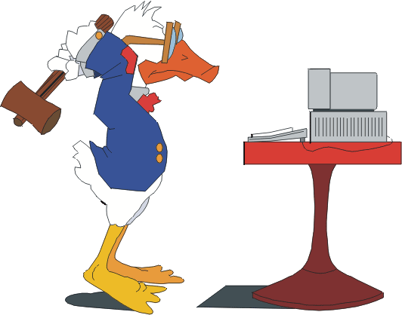

GBL Concerns
Student/Teacher Buy-In (Whitton, 2012; Dickey, 2011)
Socioeconomic Factors (Ke, 2008a)
(I Hate Computers, 2012)
(Zisk, 2012)
(Computer Love, 2012)
Notes:
Still even with the perfect game-based learning program in place, success will be completely dependent upon the buy-in of the participating teachers and students. Significant resources and effort must be dedicated to earning the support of these key stakeholders.
Lastly, care must be taken to accommodate for any socioeconomic issues that may hinder teacher implementation and students performance.

Slide 18
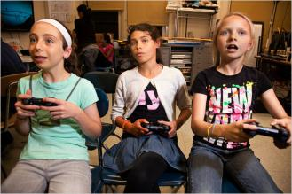
Building a Successful GBL Program
Relative Advantage
Improved Classroom Management
Streamlined Efficiency
Increased Student Engagement
(Corbett, 2010)
Notes:
Many of you may be asking why should we adopt game-based learning for our department and college?
What will GBL offer that we don’t already have?
First, once the game-based learning units are developed, classroom management, interactions, and support will be much more efficient than our current traditional courses. In addition, Students will be increasingly self-motivated and actively engaged in learning.

Slide 19



Building a Successful GBL Program
Compatibility
Strong Framework for an Innovative Future
Cost Effective
Gives Us an Edge Over Competing Colleges
(SKC Tech Prep, 2013)
Notes:
Moreover, the game-based learning program will fall directly in-line with our college mission to seek out innovations that will engage students in learning within a vibrant, dynamic learning environment.
Cost effective game packages will also help to alleviate issues which stem from the socioeconomic situations of many of our students.
Our effective implementation of game-based learning using cutting edge technology will also give us an edge over other colleges in our state. As a result we will be able to attract a new class of students who are seeking an immersive and challenging educational experience.

Slide 20
Building a Successful GBL Program
Complexity
Ready-to-Use Curriculum Package
Built-In Summative and Formative Assessments
Online and Face-to-Face Training and Support
Notes:
In order to make our game-based learning program as easy to implement as possible, our college and department GBL experts will first develop a comprehensive GBL curriculum package which other participating teachers will be able to use as-is even with a limited computer and gaming background. These ready-to-use immersive gaming packages will also have built-in summative and formative assessments which automatically log learning statistics for each student.
To further ease the stress held by hesitant teachers and students, regular online and face-to-face tutorials, webinars, and support resources will be readily available to all participants.

Slide 21

Building a Successful GBL Program
Trialability
Small-Scale Pilot
Excited Core Group of Early Adopters
Limited Traditional Courses Still Offered
Notes:
In order to test and fine-tune our new GBL program, our curriculum will first be implemented in a small-scale pilot lead by our most enthusiastic teachers. Their early adoption and testing of the program will allow them to act as key opinion leaders when presenting their findings to the rest of the department and to our college administrators. Based on their recommendations and efforts, the others in the department will be able to see its success and will have reliable mentors to offer support.
Since there will still be a small group of students and teachers which will likely remain very uncomfortable with the technologically intensive GBL curriculum, a limited number of traditional course sections will still be offered for at least the first two years after full-scale implementation is underway.

Slide 22

Building a Successful GBL Program
Observability
Semester Student Data
Open-Access to Participating Classrooms
Routine Visits to Colleges Implementing GBL
Notes:
At the conclusion of each semester of implementation, our department experts will collect and analyze student performance and affect data and then share their findings and conclusions with all interested parties in a open forum. Also in an effort to increase the transparency of our program, we will encourage everyone to observe and interact with our GBL students and teachers. Furthermore, all interested individuals outside of our school will also be encouraged to visit and observe our GBL classrooms in action. In a similar manner, our faculty members will be encouraged to visit and observe GBL programs at other colleges and institutions. As a result, we will gain a comprehensive knowledge and experience base upon which we can make the most informed decisions possible pertaining to our GBL program and its future.

Slide 23

Building a Successful GBL Program
Centralized Diffusion
GBL Experts
College Innovation Committee
Department Innovation Team
Notes:
A centralized diffusion strategy will likely be the most effective and organized approach for developing and implementing our GBL program. This approach allows GBL experts at the department and college levels to lead the charge in adopting this groundbreaking innovation. This small body of change agents will make many of the decision pertaining to successful operation of the GBL program while seeking regular guidance and feedback from the participating faculty members and students. Centralized diffusion also will provide a more systematic, organized, and efficient control structure for the GBL program.

Slide 24

Building a Successful GBL Program
Communication Channels
Online Media, Training, and Workshops
Regular Face-to-Face Support Groups
Teaching Partnerships
Additional Information:
Game-Based Learning: Developing an Institutional Strategy
(http://www.educause.edu/library/resources/game-based-learning-developing-institutional-strategy)
Notes:
Since effective and regular communication is crucial to the implementation of any program, a collection of online resources, tutorials, and workshops will be made available to instruct teachers on best practices and semantics of the GBL program.
Face-to-face support groups will also be formed where teachers can routinely share ideas and resolve concerns.
Teacher partnerships will also be utilized, pairing less experienced and more experienced GBL teachers together. This will provide a mentor for teachers who lack the confidence, ability, and experience often required for effective implementation of the GBL curriculum.

Slide 25

Adopting GBL:
Knowledge/Persuasion
“See a need, fill a need.”
(Twentieth Century Fox, 2009)
Improve Student Engagement
Example of Innovation
Begin the Journey
Today
April 2013
Additional Information:
Game-Based Learning: What it is, Why it Works, and Where it's Going
(http://www.newmedia.org/game-based-learning--what-it-is-why-it-works-and-where-its-going.html)
Notes:
In this day and age, there is a very real need for the educational system to adapt to this new wave of tech savvy learners who are hungry for opportunity to engage in an immersive, enlightening world. We must now take the advise of Bidweld for the popular film Robots…”See a need, fill a need.” GBL will fill this need. This initiative will improve student engagement and will make our institution a shining example to the world of innovation.
(click)
Let’s begin this incredible journey today!

Slide 26

Adopting GBL:
Knowledge/Persuasion
(Digital Media & Learning Research, 2012)
Additional Information:
Two to Three Years: Game-Based Learning
(http://wp.nmc.org/horizon2011/sections/game-based-learning/)
Notes:
If the following clip, Professor James Gee of Arizona State University explains that an educational revolution is upon us, and those institutions that embrace the ensuing changes with open arms will effectually lead academia to a promising future. We have an opportunity now to be on the front lines of this charge.
(click)
(This slide begins with a video of Professor James Gee of Arizona State University as he comments on the evolution of learning and the building pressure for traditional schools to adapt and change to meet the needs of the rising generation of learners)

Slide 27
Adopting GBL:
Making the Decision
A two to three year road to adoption (Epper, Derryberry, & Jackson, 2012)
Pilot:
Fall 2013 – Spring 2014
Math Department Adoption Decision:
April 2014
Additional Information:
Game-Based Learning: Developing an Institutional Strategy
(http://www.educause.edu/library/resources/game-based-learning-developing-institutional-strategy)
Notes:
Many experts agree that the adoption process for game-based learning curricula typically takes two to three years (Epper, Derryberry, & Jackson, 2012). In accordance with this suggested plan, we can start training our core group of department GBL experts and teachers during the summer of 2013. Then we can begin our small-scale GBL pilot in the Fall semester of 2013 and Spring semester of 2014. At the conclusion of the Spring semester of 2014, the department innovation team and experts will lead a presentation and discussion of the pilot results. At the conclusion of this discussion, any recommended revisions will be made to the program, and the decision for full-scale department adoption of the GBL program will be made.

Slide 28
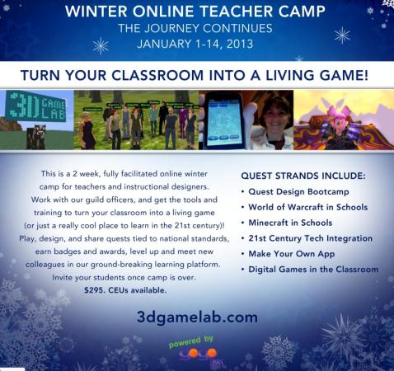
Adopting GBL:
Implementation Plan
Training
Summer 2014
Full Implementation
Fall 2014
to
Spring 2016
Additional Information:
How 10 Colleges Are Using Game-Based Learning Right Now
(http://edudemic.com/2012/10/colleges-game-based-learning/)
Notes:
During the summer following the decision to adopt GBL department-wide, all participating teachers will take part in online and face-to-face workshops focused on helping them to design and use the GBL curriculum. Potential development opportunities could include the 3D Game Lab sponsored by Boise State University in Idaho and various other labs, workshops and conferences sponsored by other colleges and institutions who have developed strong GBL programs.
Following this training full implementation can begin in the Fall of 2014 and continue for two successive school years.

Slide 29

Adopting GBL:
Implementation Plan
(Eria Interactive, 2012)
Additional Information:
How 10 Colleges Are Using Game-Based Learning Right Now
(http://edudemic.com/2012/10/colleges-game-based-learning/)
Notes:
The following clip of the Progenitor X Project is one example of some GBL programs that other institutions have developed. In this game, the user is working with an elite team of scientists on a quest to find a cure for the zombie epidemic sweeping the land. The core content is focused on biology science and real-world problem solving.
(c lick)
(Play video)

Slide 30

Adopting GBL:
Confirmation Plan
Recent data and analyses available at the conclusion of each semester.
Official Program Evaluation & Conclusions
April 2016
  Is GBL achieving desired outcomes?
  How can GBL achieve outcomes more effectively?
  Are there alternatives to GBL that would work better at our institution?
(How Are We Doing, 2012)
Additional Information:
NMC Horizon Report > 2012 Higher Ed Edition
(http://www.nmc.org/publications/horizon-report-2012-higher-ed-edition)
Notes:
At the end of each semester of implementation, data will be analyzed and shared with all stakeholders (i.e. students, teachers, staff, and the college administration). This data sharing will be conducted in an open forum to ensure program quality and to revise the program as necessary.
Following the first two years of full-scale implementation (i.e. April 2016), the program will once again undergo a comprehensive evaluation to determine its effectiveness and potential for future success. At the program evaluation, decisions will be made based on answers to the following questions:
Is GBL achieving desired outcomes?
How can GBL achieve outcomes more effectively?
Are there alternatives to GBL that would work better at our institution?

Slide 31
Adopting GBL:
Summary & Timeline
Date | Adoption Phase | Target Audience | Description
April 2013 | KNOWLEDGE | GBL Experts Early Adopters | Begin the adoption process by learning about GBL and its potential applications in education.
May 2013 | PERSUASION | GBL Experts Early Adopters | Hands-on workshop focused on promoting a positive attitude towards GBL.
Summer 2013 | COMMUNICATION & SUPPORT | GBL Experts Early Adopters | Additional online and face-to-face training and curriculum development workshops
Fall 2013 to Spring 2014 | IMPLEMENTATION | GBL Experts Early Adopters | Pilot GBL program initiated.
Notes:
Let’s review our suggested timeline for our GBL program development, implementation, and evaluation.
Date: April 2013 Adoption Phase: KNOWLEDGE Target Audience: GBL Experts, Early Adopters
Description: The adoption process will begin as GBL experts and early adopters learn about GBL and its potential applications in education. GBL experts and early adopters will include a small core group of math department teachers and college administrators who are enthusiastic about technology enhanced teaching and learning and who are willing to sacrifice time and effort to give the GBL program its best possible chance of success.
Date: May 2013 Adoption Phase: PERSUASION Target Audience: GBL Experts, Early Adopters
Description: GBL experts and early adopters will be invited to participate in a hands-on workshop focused on promoting a positive attitude towards GBL. In this workshop participants will be immersed in virtual GBL worlds and projects that other colleges and innovators have already designed and implemented successfully.
Date: Summer 2013 Adoption Phase: COMMUNICATION & SUPPORT Target Audience: GBL Experts, Early Adopters
Description: Participants will engage in additional online and face-to-face training and curriculum development workshops.
Date: Fall 2013 - Spring 2014 Adoption Phase: IMPLEMENTATION Target Audience: GBL Experts, Early Adopters
Description: The pilot GBL program will be initiated.

Slide 32
Adopting GBL:
Summary & Timeline
Date | Adoption Phase | Target Audience | Description
April 2014 | DECISION | All Stakeholders | Pilot program evaluation and department-wide adoption decision made.
Summer 2014 | COMMUNICATION & SUPPORT | All Stakeholders | Additional online and face-to-face training and curriculum development workshops
August 2014 | COMMUNICATION & SUPPORT | All Stakeholders | GBL support groups and teaching partnerships initiated.
Fall 2014 to Spring 2016 | IMPLEMENTATION | All Stakeholders (except laggards) | Department-wide GBL program implementation.
Notes:
Date: April 2014 Adoption Phase: DECISION Target Audience: All Stakeholders (i.e. GBL Experts, Early Adopters, Early Majority, Late Majority, Laggards, and College Administration)
Description: All stakeholders will participate in the pilot program evaluation, and a department-wide adoption decision will be made.
Date: Summer 2014 Adoption Phase: COMMUNICATION & SUPPORT Target Audience: All Stakeholders
Description: Participants will engage in additional online and face-to-face training and curriculum development workshops.
Date: August 2014 Adoption Phase: COMMUNICATION & SUPPORT Target Audience: All Stakeholders
Description: GBL support groups and teaching partnerships will be initiated.
Date: Fall 2014 - Spring 2016 Adoption Phase: IMPLEMENTATION Target Audience: All Stakeholders (except laggards)
Description: Department-wide GBL program implementation will begin.

Slide 33
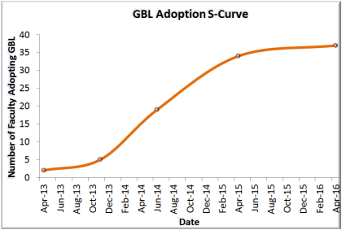
Adopting GBL:
Summary & Timeline
Date | Adoption Phase | Target Audience | Description
2014-2016 | CONFIRMATION | All Stakeholders | Program data will be analyzed and shared with all stakeholders after each semester of implementation.
April 2016 | CONFIRMATION & DECISION | All Stakeholders | Full GBL program evaluation and review will be conducted and continuance decisions will be made.
Post April 2016 | IMPLEMENTATION | Laggards | At this point, laggards will be required to begin using the GBL program dependent upon the continuance decision.
Notes:
Date: 2014-2016 Adoption Phase: CONFIRMATION Target Audience: All Stakeholders
Description: At the conclusion of each semester of implementation, program data will be analyzed and shared with all stakeholders.
Date: April 2016 Adoption Phase: CONFIRMATION & DECISION Target Audience: All Stakeholders
Description: Full GBL program evaluation and review will be conducted and continuance decisions will be made.
Date: Post April 2016 Adoption Phase: IMPLEMENTATION Target Audience: Laggards
Description: At this point, laggards will be required to begin using the GBL program dependent upon the continuance decision.

Slide 34


The Big Picture: GBL Impact on Society
Invest in a Bright Future!
A Workforce of Adept Problem-Solvers
Global Engagement and Collaboration
Multicultural Awareness
(Beat the Struggle, 2012)
Notes:
Your choice today to adopt and implement the proposed game-based learning program will have a far-reaching impact far beyond the walls of our institution. Students will take their unforgettable experiences with them to future homes, businesses, and communities, and they will show the world that they will not back down from a challenge. They will tackle problems head-on and will work successfully with a global network of colleagues to find creative, innovative solutions. They will also pass on the respect they have gained for people of all walks life and will integrate multicultural perspectives into everything they do.
(click)
The train of educational innovation and change is here. Let’s choose to climb onboard and begin our journey to a bright future filled with engagement, imagination, and endless wonder…

Slide 35

The Time for Action is NOW!
(Canton, Gale, & Zemeckis, 1990)
Notes:
The time for action is NOW!

Slide 36

(European Space Agency & Nasa, 2003)
References
Advanced Technology Korea. (2011). Game-based learning [Photograph]. Retrieved from http://www.advancedtechnologykorea.com/4514
Australian Teacher Magazine. (2013). Innovation [Photograph]. Retrieved from http://ozteacher.com.au/html/index.php?option=com_content&view=article&id=2389:being-game-to-be-engaging-pays-off&catid=33:innovation&Itemid=410
Bag of Money [Graphic]. (2012). Retrieved from http://www.camarillochamber.org/save-money/
Beat the Struggle. (2012). Bright Future [Photograph]. Retrieved from http://www.beatthestruggle.com/the-future-is-bright-jeremy-grantham-is-mistaken/
Bouchard, S. (2011, November 8). Chocolate covered broccoli: Building better games [video file]. Retrieved from http://www.youtube.com/watch?v=VrK7VXCfsS0
Britannica Kids (2013). Abacus [Photograph]. Retrieved from http://kids.britannica.com/elementary/art-86844/The-abacus-is-an-ancient-device-to-help-solve-math
Brom, C., Šisler, V., & Slavík, R. (2010). Implementing digital game-based learning in schools: Augmented learning environment of ‘Europe 2045’. Multimedia Systems, 16(1), 23-41. doi:10.1007/s00530-009-0174-0
Canton, N. (Producer), Gale, B. (Producer), & Zemeckis, R. (Director). (1990). Back to the Future 3 [Motion Picture]. United States of America: Universal Pictures.
Cognitoy. (2000). Mindrover [Computer Software].
Computer Love [Graphic]. (2012). Retrieved from http://www.clipartheaven.com/clipart/computers/computer_love_2.gif
Corbett, S. (2010). Learn by Playing [Photograph]. Retrieved from http://www.nytimes.com/2010/09/19/magazine/19video-t.html?pagewanted=all&_r=0
Critical Mass Interactive. (2011). Tron [Graphic]. Retrieved from http://www.criticalmassinteractive.com/wp-content/uploads/2011/06/tron_slideshow1-640x250.jpg
Dede, C. (2011, September). The advantages and challenges of designing immersive learning experiences. Paper presented at the 33rd Annual Conference of the International Society for Technology in Education (ISTE), San Diego, CA. Retrieved from http://www.isteconference.org/2012/uploads/KEY_70279486/DedeISTESig2012.pdf
Dickey, M. D. (2011). Murder on Grimm Isle: The impact of game narrative design in an educational game-based learning environment. British Journal Of Educational Technology, 42(3), 456-469. doi:10.1111/j.1467-8535.2009.01032.x
Digital Media and Learning Research. (2012). Games and Education Scholar James Paul Gee on Video Games, Learning, and Literacy [Video]. Retrieved from http://www.youtube.com/watch?v=LNfPdaKYOPI
Entertainment Software Association (ESA). (2012). 2012 sales, demographic and usage data: Essential facts about the computer and video game industry. Retrieved from http://www.theesa.com/facts/pdfs/ESA_EF_2012.pdf
Entertainment Software Rating Board (ESRB). (2010). How much do you know about video games? Retrieved from http://www.esrb.org/about/video-game-industry-statistics.jsp
Epper, R. M., Derryberry, A., Jackson, S. (2012). Game-based learning: Developing an institutional strategy [Research Bulletin]. Louisville, CO: EDUCAUSE Center for Applied Research. Retrieved from http://www-cdn.educause.edu/ir/library/pdf/ERB1208.pdf
Eria Interactive. (2012). Progenitor X Trailer [Video]. Retrieved from http://youtu.be/3SES8EKUbCM
European Space Agency & NASA. (2003). The Boomerang Nebula [Photograph]. Retrieved from http://www.spacetelescope.org/images/heic0301a/
Gaudiosi, J. (2011). Girl Gamer [Photograph]. Retrieved from http://blogs-images.forbes.com/johngaudiosi/files/2011/11/girlgamer.jpg
Groff, J., Howells, C., & Cranmer, S. (2010). The impact of console games in the classroom: Evidence from schools in Scotland. UK: Futurelab. Retrieved from http://www.academia.edu/706362/The_Impact_of_Console_Games_in_the_Classroom_Evidence_From_Schools_in_Scotland
How Are We Doing [Graphic]. (2012). Retrieved from http://www.hotelbuenaparkanaheim.com/inc/images/little_guy.gif
Hurtsville City Library. (2013). Old school bag [Photograph}. Retrieved from http://lmg.hurstville.nsw.gov.au/Education-Programs.html
I Hate Computers [Graphic]. (2012). Retrieved from http://logintoliteracy.files.wordpress.com/2012/02/i-hate-computers.gif
Julian, D. (2012). FEA ikids fasttimes [Photograph]. Retrieved from http://www.edutopia.org/ikids
Ke, F. (2008a). Alternative goal structures for computer game-based learning. International Journal Of Computer-Supported Collaborative Learning, 3(4), 429-445. doi:10.1007/s11412-008-9048-2
Ke, F. (2008b). Computer games application within alternative classroom goal structures: cognitive, metacognitive, and affective evaluation. Educational Technology Research & Development, 56(5/6), 539-556. doi:10.1007/s11423-008-9086-5
Le, S. (Artist). (2011). Digital game-based learning cartoon [Cartoon Drawing]. Retrieved from http://www.flickr.com/photos/donjonson/5351362611/
Limex Games. (2010). Cargo Bridge [Graphic]. Retrieved from http://blog.mochigames.com/2011/11/17/best-of-browser-games-physics-bridge-building/
Luis, M. (2012). GREAT game-based learning [Video]. Retrieved from http://youtu.be/_gBi7OXjpAE
Martin, P. (2010). IT Computer Girl [Graphic]. Retrieved from http://www.plugintotechnology.com/2010/11/educational-video-games-create-engaged.html
McCurry, M. (2010). Boring lecture [Photograph]. Retrieved from http://www.michaelmccurry.net/2010/10/20/lecture-based-vs-interactive-learning-which-is-future-of-education/
Meyers, A. (2009). A vision for 21st century learning [Video]. Retrieved from http://youtu.be/Mirxkzkxuf4
National Insitute of Standards & Technology (NIST). (2013). Hassler’s Slide Rule [Photograph]. Retrieved from http://museum.nist.gov/object.asp?ObjID=5
Nys, R. (2011). Digital Learner [Photograph]. Retrieved from http://roxannnys.pbworks.com/w/page/6883448/21st%20Century%20Learners%20vs%2020th%20Century%20Teachers
Online Education. (2012). A Video Game Timeline (1967-Present) [Photograph]. Retrieved from http://www.onlineeducation.net/videogame_timeline
Prensky, M. (2001). The digital game-based learning revolution. In Digital Game-Based Learning (pp. 1-19). New York: McGraw-Hill.
Ravado, R. (2010a). If you fall asleep during class [Photograph]. Retrieved from http://rikravado.hubpages.com/hub/Web-Based-Learning-Todays-Educated-Answer#
Ravado, R. (2010b). Modern web-based learning with opportunities to collaborate [Photograph]. Retrieved from http://rikravado.hubpages.com/hub/Web-Based-Learning-Todays-Educated-Answer#
Ravado, R. (2010c). Traditional learning [Photograph]. Retrieved from http://rikravado.hubpages.com/hub/Web-Based-Learning-Todays-Educated-Answer#
Rogers, E. M. (2003). Diffusion of innovations (5th ed.). New York, NY: Free Press.
Second Life. (2012). Second Life [Video]. Retrieved from http://www.youtube.com/watch?v=r74hkI-JcHY&feature=share&list=PLA4A56B2AB33F7723
Sigurdardottir, H. (2012). Debating matters in digital game-based learning. Proceedings of the European Conference on Games Based Learning, 471-477.
SKC Tech Prep. (2013). Computer Student [Photograph]. Retrieved from http://www.skctechprep.org/
Socialphy. (2012). Video Games Make Learning Fun [Photograph]. Retrieved from http://www.socialphy.com/posts/off-topic/12473/10-Reasons-Why-Video-Games-Are-Good-For-You.html
Southwest Research Institute. (2013). Game-based learning [Photograph]. Retrieved from http://www.swri.org/4org/d07/tspi/gamebased.htm
Spires, H. A., Rowe, J. P., Mott, B. W., & Lester, J. C. (2011). Problem solving and game-based learning: effects of middle grade students' hypothesis testing strategies on learning outcomes. Journal of Educational Computing Research, 44(4), 453-472. doi:10.2190/EC.44.4.e
Tang, S., Hanneghan, M. and El Rhalibi, A. (2009). Introduction to games-based learning. In T. Connolly, M. Stansfield, & E. Boyle, Games-based learning advancement for multisensory human computer interfaces: Techniques and effective practices (pp. 1-77).
Tsai, F.-H., Yu, K.-C., & Hsiao, H.-S. (2012). Exploring the factors influencing learning effectiveness in digital game-based learning. Educational Technology & Society, 15 (3), 240–250. Retrieved from http://www.ifets.info/journals/15_3/18.pdf
Twentieth Century Fox. (2004). Bigweld [Photograph]. Retrieved from http://www.imdb.com/media/rm2812320000/tt0358082
Vogel, J. J., Greenwood-Ericksen, A., Cannon-Bowers, J., & Bowers, C. A. (2006). Using Virtual Reality with and without Gaming Attributes for Academic Achievement. Journal of Research on Technology in Education, 39(1), 105-118.
Whitton, N. (2012). The place of game-based learning in an age of austerity. Electronic Journal of E-Learning, 10(2), 249-256.
Whole Artist Studio. (2011). Choices [Graphic]. Retrieved from http://wholeartiststudio.com/wp-content/uploads/2011/12/Choices.jpg
Zhi-Hong, C., Liao, C. Y., Cheng, H. H., Yeh, C. C., & Tak-Wai, C. (2012). Influence of game quests on pupils' enjoyment and goal-pursuing in math learning. Journal of Educational Technology & Society, 15(2), 317-327.
Zisk, J. (2012). Teacher Thinking [Photograph]. Retrieved from http://teacheronline.us/flip/teacher_thinking.gif

Slide 37
References
Advanced Technology Korea. (2011). Game-based learning [Photograph]. Retrieved from http://www.advancedtechnologykorea.com/4514
Australian Teacher Magazine. (2013). Innovation [Photograph]. Retrieved from http://ozteacher.com.au/html/index.php?option=com_content&view=article&id=2389:being-game-to-be-engaging-pays-off&catid=33:innovation&Itemid=410
Bag of Money [Graphic]. (2012). Retrieved from http://www.camarillochamber.org/save-money/
Beat the Struggle. (2012). Bright Future [Photograph]. Retrieved from http://www.beatthestruggle.com/the-future-is-bright-jeremy-grantham-is-mistaken/
Bouchard, S. (2011, November 8). Chocolate covered broccoli: Building better games [video file]. Retrieved from http://www.youtube.com/watch?v=VrK7VXCfsS0
Britannica Kids (2013). Abacus [Photograph]. Retrieved from http://kids.britannica.com/elementary/art-86844/The-abacus-is-an-ancient-device-to-help-solve-math

Slide 38
References
Brom, C., Šisler, V., & Slavík, R. (2010). Implementing digital game-based learning in schools: Augmented learning environment of ‘Europe 2045’. Multimedia Systems, 16(1), 23-41. doi:10.1007/s00530-009-0174-0
Canton, N. (Producer), Gale, B. (Producer), & Zemeckis, R. (Director). (1990). Back to the Future 3 [Motion Picture]. United States of America: Universal Pictures.
Cognitoy. (2000). Mindrover [Computer Software].
Computer Love [Graphic]. (2012). Retrieved from http://www.clipartheaven.com/clipart/computers/computer_love_2.gif
Corbett, S. (2010). Learn by Playing [Photograph]. Retrieved from http://www.nytimes.com/2010/09/19/magazine/19video-t.html?pagewanted=all&_r=0
Dede, C. (2011, September). The advantages and challenges of designing immersive learning experiences. Paper presented at the 33rd Annual Conference of the International Society for Technology in Education (ISTE), San Diego, CA. Retrieved from http://www.isteconference.org/2012/uploads/KEY_70279486/DedeISTESig2012.pdf.

Slide 39
References
Dickey, M. D. (2011). Murder on Grimm Isle: The impact of game narrative design in an educational game-based learning environment. British Journal Of Educational Technology, 42(3), 456-469. doi:10.1111/j.1467-8535.2009.01032.x
Digital Media and Learning Research. (2012). Games and Education Scholar James Paul Gee on Video Games, Learning, and Literacy [Video]. Retrieved from http://www.youtube.com/watch?v=LNfPdaKYOPI
Entertainment Software Association (ESA). (2012). 2012 sales, demographic and usage data: Essential facts about the computer and video game industry. Retrieved from http://www.theesa.com/facts/pdfs/ESA_EF_2012.pdf
Entertainment Software Rating Board (ESRB). (2010). How much do you know about video games? Retrieved from http://www.esrb.org/about/video-game-industry-statistics.jsp
Epper, R. M., Derryberry, A., Jackson, S. (2012). Game-based learning: Developing an institutional strategy [Research Bulletin]. Louisville, CO: EDUCAUSE Center for Applied Research. Retrieved from http://www-cdn.educause.edu/ir/library/pdf/ERB1208.pdf
Eria Interactive. (2012). Progenitor X Trailer [Video]. Retrieved from http://youtu.be/3SES8EKUbCM

Slide 40
References
European Space Agency & NASA. (2003). The Boomerang Nebula [Photograph]. Retrieved from http://www.spacetelescope.org/images/heic0301a/
Gaudiosi, J. (2011). Girl Gamer [Photograph]. Retrieved from http://blogs-images.forbes.com/johngaudiosi/files/2011/11/girlgamer.jpg
Groff, J., Howells, C., & Cranmer, S. (2010). The impact of console games in the classroom: Evidence from schools in Scotland. UK: Futurelab. Retrieved from http://www.academia.edu/706362/The_Impact_of_Console_Games_in_the_Classroom_Evidence_From_Schools_in_Scotland
How Are We Doing [Graphic]. (2012). Retrieved from http://www.hotelbuenaparkanaheim.com/inc/images/little_guy.gif
Hurtsville City Library. (2013). Old school bag [Photograph}. Retrieved from http://lmg.hurstville.nsw.gov.au/Education-Programs.html
I Hate Computers [Graphic]. (2012). Retrieved from http://logintoliteracy.files.wordpress.com/2012/02/i-hate-computers.gif

Slide 41
References
Julian, D. (2012). FEA ikids fasttimes [Photograph]. Retrieved from http://www.edutopia.org/ikids
Ke, F. (2008a). Alternative goal structures for computer game-based learning. International Journal Of Computer-Supported Collaborative Learning, 3(4), 429-445. doi:10.1007/s11412-008-9048-2
Ke, F. (2008b). Computer games application within alternative classroom goal structures: cognitive, metacognitive, and affective evaluation. Educational Technology Research & Development, 56(5/6), 539-556. doi:10.1007/s11423-008-9086-5
Le, S. (Artist). (2011). Digital game-based learning cartoon [Cartoon Drawing]. Retrieved from http://www.flickr.com/photos/donjonson/5351362611/
Limex Games. (2010). Cargo Bridge [Graphic]. Retrieved from http://blog.mochigames.com/2011/11/17/best-of-browser-games-physics-bridge-building/
Luis, M. (2012). GREAT game-based learning [Video]. Retrieved from http://youtu.be/_gBi7OXjpAE

Slide 42
References
Martin, P. (2010). IT Computer Girl [Graphic]. Retrieved from http://www.plugintotechnology.com/2010/11/educational-video-games-create-engaged.html
McCurry, M. (2010). Boring lecture [Photograph]. Retrieved from http://www.michaelmccurry.net/2010/10/20/lecture-based-vs-interactive-learning-which-is-future-of-education
Meyers, A. (2009). A vision for 21st century learning [Video]. Retrieved from http://youtu.be/Mirxkzkxuf4
National Insitute of Standards & Technology (NIST). (2013). Hassler’s Slide Rule [Photograph]. Retrieved from http://museum.nist.gov/object.asp?ObjID=5
Nys, R. (2011). Digital Learner [Photograph]. Retrieved from http://roxannnys.pbworks.com/w/page/6883448/21st%20Century%20Learners%20vs%2020th%20Century%20Teachers
Online Education. (2012). A Video Game Timeline (1967-Present) [Photograph]. Retrieved from http://www.onlineeducation.net/videogame_timeline

Slide 43
References
Prensky, M. (2001). The digital game-based learning revolution. In Digital Game-Based Learning (pp. 1-19). New York: McGraw-Hill.
Ravado, R. (2010a). If you fall asleep during class [Photograph]. Retrieved from http://rikravado.hubpages.com/hub/Web-Based-Learning-Todays-Educated-Answer#
Ravado, R. (2010b). Modern web-based learning with opportunities to collaborate [Photograph]. Retrieved from http://rikravado.hubpages.com/hub/Web-Based-Learning-Todays-Educated-Answer#
Ravado, R. (2010c). Traditional learning [Photograph]. Retrieved from http://rikravado.hubpages.com/hub/Web-Based-Learning-Todays-Educated-Answer#
Rogers, E. M. (2003). Diffusion of innovations (5th ed.). New York, NY: Free Press.
Second Life. (2012). Second Life [Video]. Retrieved from http://www.youtube.com/watch?v=r74hkI-JcHY&feature=share&list=PLA4A56B2AB33F7723

Slide 44
References
Sigurdardottir, H. (2012). Debating matters in digital game-based learning. Proceedings of the European Conference on Games Based Learning, 471-477.
SKC Tech Prep. (2013). Computer Student [Photograph]. Retrieved from http://www.skctechprep.org/
Socialphy. (2012). Video Games Make Learning Fun [Photograph]. Retrieved from http://www.socialphy.com/posts/off-topic/12473/10-Reasons-Why-Video-Games-Are-Good-For-You.html
Southwest Research Institute. (2013). Game-based learning [Photograph]. Retrieved from http://www.swri.org/4org/d07/tspi/gamebased.htm
Spires, H. A., Rowe, J. P., Mott, B. W., & Lester, J. C. (2011). Problem solving and game-based learning: effects of middle grade students' hypothesis testing strategies on learning outcomes. Journal of Educational Computing Research, 44(4), 453-472. doi:10.2190/EC.44.4.e
Tang, S., Hanneghan, M. and El Rhalibi, A. (2009). Introduction to games-based learning. In T. Connolly, M. Stansfield, & E. Boyle, Games-based learning advancement for multisensory human computer interfaces: Techniques and effective practices (pp. 1-77).

Slide 45
References
Tsai, F.-H., Yu, K.-C., & Hsiao, H.-S. (2012). Exploring the factors influencing learning effectiveness in digital game-based learning. Educational Technology & Society, 15 (3), 240–250. Retrieved from http://www.ifets.info/journals/15_3/18.pdf
Twentieth Century Fox. (2004). Bigweld [Photograph]. Retrieved from http://www.imdb.com/media/rm2812320000/tt0358082
Vogel, J. J., Greenwood-Ericksen, A., Cannon-Bowers, J., & Bowers, C. A. (2006). Using Virtual Reality with and without Gaming Attributes for Academic Achievement. Journal of Research on Technology in Education, 39(1), 105-118.
Whitton, N. (2012). The place of game-based learning in an age of austerity. Electronic Journal of E-Learning, 10(2), 249-256.
Whole Artist Studio. (2011). Choices [Graphic]. Retrieved from http://wholeartiststudio.com/wp-content/uploads/2011/12/Choices.jpg
Zhi-Hong, C., Liao, C. Y., Cheng, H. H., Yeh, C. C., & Tak-Wai, C. (2012). Influence of game quests on pupils' enjoyment and goal-pursuing in math learning. Journal of Educational Technology & Society, 15(2), 317-327.

Slide 46
References
Zisk, J. (2012). Teacher Thinking [Photograph]. Retrieved from http://teacheronline.us/flip/teacher_thinking.gif

