Slide 1
Simplify! A Successful Approach for Teaching Developmental Math
2009 AMATYC Conference
Las Vegas, NV
Presented by:
Cindy Alder &
Tammy German

Slide 2
Who are your students?

Slide 3
Developmental Students
Capable students who have simply fallen behind.
Students that have a specific weakness in mathematics.
Students with severe math anxiety.
Students that are motivated, but are deficient in generalized learning skills as well as math-specific skills.
Students with who have documented learning disabilities, some in multiple areas including mathematical abilities, learning skills, motivation, organizational skills, and others.

Slide 4
Expectations for Developmental Students
As instructors, we need to be very clear with our students about our expectations of them for our class.
Students are ultimately responsible for their own success.
There are some things students just need to memorize.
  Multiplication Facts
  Vocabulary
  Order of Operation Rules
  Rules of Exponents
  etc.

Slide 5
Catch Phrases & Stories

Slide 6
Catch Phrases & Stories
We have found that catch phrases and stories help our students memorize, recall, and retain important mathematical concepts.
  PE(r)MDAS – Please Excuse(r) My Dear Aunt Sally
  Slope Story
    Positive on the way up, negative on the way down, zero on the horizontal, and none (die) on the vertical.
  Addition & Subtraction of Integers –walk numbers off on a number line.
  Division
    Int0 Zero
    By Zero
Notes:
Addition & Subtraction of Integers – Place numbers on floor, walk numbers off on a number line. Face the + end of the number line, for a positive number walk forward. For a negative number walk backward. For subtraction turn around.
Ex. -2- (-3) – face positive walk backward two steps turn around walk backward three steps. You are now on +1.
Multiplication of Integers –
3*(-2) – face positive – take two steps backward three times
(-3)*(-2) – face negative – take two steps backward three times

Slide 7
Catch Phrases & Stories
  Plotting Points – Battleship
  Changing Percents to Decimals and Decimals to Percents (Alphabet)
  Commutative Properties & Associative Properties (commute – in a community people move around, or commute. Your best friend is always your best friend even if you associate with other people)
  Greatest Common Factor – Group of Common Terms & Least Common Multiple – include Leftovers.
  Simplifying Radicals – Dating Story
  Solving Equations – Balance
  Quadratic Formula Song (tune of Pop Goes the Weasel)

Slide 8
Catch Phrases & Stories
  D = rt (Dentist = Rotten teeth)
  Negative Exponents – to have a positive experience, they must move upstairs or downstairs.
  Simplifying rational exponents – flower power
  Inequalities – Alligator Mouth
  Denominator – Down
  Factoring sum and difference of cubes. (match the sign, change the sign, plus, plus)
  Dividing Fractions - Copy Dot Flip
  Parabolas
– –
+ +

Slide 9
Make it Visual

Slide 10
Make it Visual
Venn Diagrams for Finding GCF & LCM
  Find the GCF and LCM of 12 and 54.
Factors of
12
Factors of
54
3
2
2
3
3
GCF

Slide 11
Make it Visual
Long Bar for Simplifying Fractions
1
1
1
1

Slide 12
CATCH PHRASE BREAK!!
Radical Dating

Slide 13
Simplify:
Keep it One Way
Notes:
In mathematics, there are often multiple ways to solving a given problem. We have found that developmental students are more successful when they are given one specific way to solve a problem rather than multiple ways to solve a problem. When appropriate, only present concepts in one way. An example of where this can be seen is in factoring a trinomial. You could factor using guess and check, foil (do we have positive terms, negative terms or both), grouping, perfect square trinomials, etc. Stick with one method – Rainbow.

Slide 14
Notes:
Solving equations containing fractions is another place where there is multiple ways to solve the problem. We like to stick with the “Wipe-Out” Method. (Explain why it works 1st – then use it in solving simple equations and more complex equations with rational expressions. Emphasize the two conditions necessary to use this method.)

Slide 15
Keep it One Way
The “Wipe-Out” Method for Solving Equations that contain fractions.
  Conditions:
    You must have an equal sign (=). In other words, you must be working with an equation not an expression.
    You must have a common denominator on each and every term in the equation.
Notes:
Solving equations containing fractions is another place where there is multiple ways to solve the problem. We like to stick with the “Wipe-Out” Method. (Explain why it works 1st – then use it in solving simple equations and more complex equations with rational expressions. Emphasize the two conditions necessary to use this method.)

Slide 16
WIPE OUT

Slide 18
CATCH PHRASE BREAK!!
Pop Goes the
Quadratic Formula

Slide 19
Notes:
Solving equations containing fractions is another place where there is multiple ways to solve the problem. We like to stick with the “Wipe-Out” Method. (Explain why it works 1st – then use it in solving simple equations and more complex equations with rational expressions. Emphasize the two conditions necessary to use this method.)

Slide 20
Keep it One Way
Factoring Trinomials.
Notes:
We call this the acb or rainbow method. It will work for all trinomials that can be factored.

Slide 21
CATCH PHRASE BREAK!!
Snow Skiing
on the Slopes
of Utah

Slide 22
Other Ideas & In-Class Testing

Slide 23
Other Ideas
3x5 Notecards
Mathematics Journals
Graphic Organizers
In-class Group Testing
Student Presentations
Games to reinforce concepts (Bingo, Jeopardy, etc.)
Technology
Teach Test Taking Strategies
Test Corrections (explain why you missed it and rework it correctly.)
Notes:
Create a non-threatening environment where students are not afraid to ask questions or make mistakes. Have students come to the board to work on problems.
Group Work
Giving Exams in the testing center to allow time.
Incorporate study skills into the class.
Teach how to take notes – journal.
Activity Based Learning - Some students tend to be visual learners, some tend to be auditory learners, yet others tend to be kinesthetic or “hands-on” learners.
Manipulatives (virtual manipulatives)

Slide 24
In Class Group Testing
Students learn to work with others.
Students build confidence.
Students are able to determine what they know and what they don’t know, with a safety zone.
Students are able to defend their answers with reasons.
Students are better prepared for a personal test, than with a traditional review.
Students speak the language of mathematics.
Teacher have the opportunity to see what students know by listening.

Slide 26
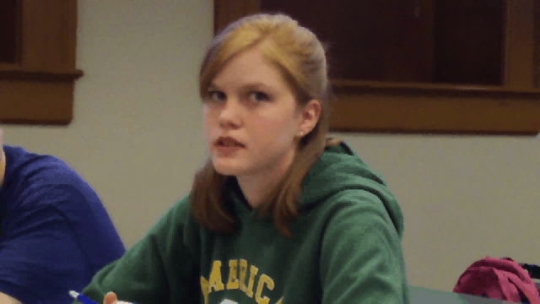

Slide 27
Contact us:
cindy.alder@snow.edu
tammy.german@snow.edu

