Slide 1
The Art of Public Speaking
Instructor: Malynda Bjerregaard

Slide 2
Chapters 1 & 2
Speaking in Public; Ethics and Public Speaking

Slide 3
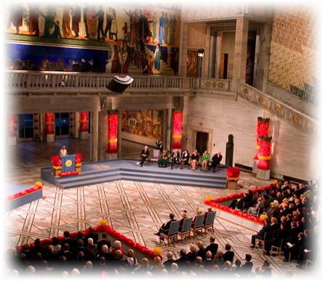
chapter 1
Speaking in Public

Slide 4
Public Speaking & Conversation
Similarities:
  Organizing thoughts logically
  Tailoring message to audience
  Telling story for maximum impact
  Adapting to feedback

Slide 5
Public Speaking & Conversation
Differences:
  Public speaking more highly structured
  Public speaking requires more
  formal language
  Public speaking requires
  different method of delivery

Slide 6

Speech Communication Process
Speaker
Message
Channel
Listener
Feedback
Interference
Situation

Slide 7
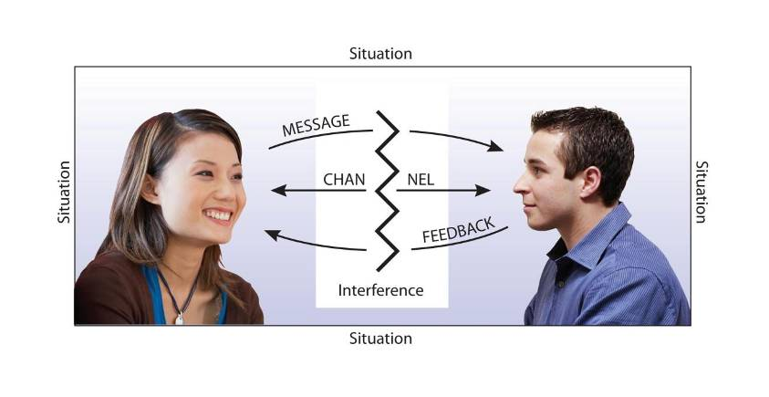
Speech Communication Process

Slide 8
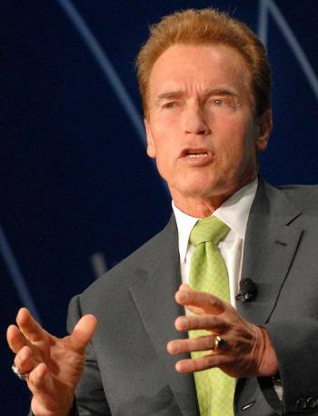
Frame of Reference
Sum of person’s knowledge, experience, goals, values, attitudes

Slide 9
Frame of Reference
Everything said is filtered through listener’s frame of reference
No two people have same frame of reference
You must speak to your audience’s frame of reference using your own

Slide 10
Ethnocentrism
Believing one’s group or culture is superior to all other groups or cultures

Slide 11
Avoiding Ethnocentrism
Respect listeners’ cultural values
Adapt messages to audience expectations
Imagine yourself in place
of listeners

Slide 12
Avoiding Ethnocentrism
Be alert to feedback
Listeners also have to avoid ethnocentrism

Slide 13
Stage Fright
Anxiety over prospect of speaking in front of audience

Slide 14
Reducing Speech Anxiety
Acquire experience
Prepare, prepare, prepare
Think positively

Slide 15
Reducing Speech Anxiety
Use power of visualization
Know that most nervousness is not visible
Don’t expect perfection

Slide 16
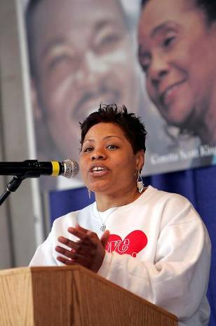
Positive Nervousness
Controlled nervousness that helps energize speaker for presentation

Slide 17
Visualization
Picture yourself giving successful speech

Slide 18
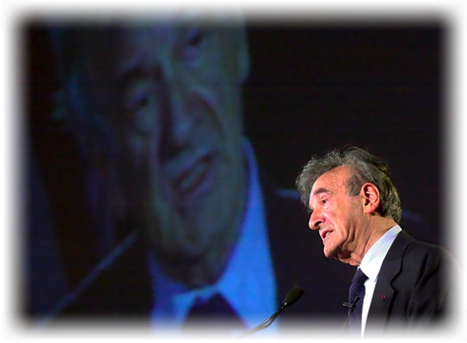
chapter 2
Ethics & Public Speaking

Slide 19
Plagiarism
Presenting language, ideas of another as one’s own

Slide 20

Types of Plagiarism
Global
Patchwork
Incremental

Slide 21
Global Plagiarism
Stealing speech from single source, passing it off as one’s own

Slide 22
Patchwork Plagiarism
Stealing ideas, language from two or three sources & passing them off as one’s own

Slide 23
Incremental Plagiarism
Failing to give credit for parts of speech borrowed from others

Slide 24
Plagiarism & Internet
Cite sources when using Internet materials
Take careful notes

Slide 25

Ethical Listening
Speechmaking a two-way street
Listeners
have ethical obligations

Slide 26
Ethical Listening Guidelines
Be courteous, attentive
Avoid prejudging speaker
Maintain free expression of ideas

Slide 27
Giving Your First Speech
Notes:
The list of slides allows instructors to navigate easily from topic to topic as they give presentations.
To print this list: Click File on the Command Bar in Microsoft PowerPoint while the title slide is showing.
Click Print on the drop down menu.
In the Print Window, click Current Page in the Print Range box and select Notes Pages from the drop-down menu under Print What
To navigate in a
Slide Show: Type the number of the slide you want to show and press the Enter key. PowerPoint will automatically display that slide.
Chapter 3 Appendix
1. Title Slide
2. Giving Your First Speech
3. Developing Your First Speech
4 Rehearsing Your First Speech
5. Using Descriptive Language
6. Gaining Attention in the Introduction
7. Linking the Conclusion to the Introduction
8. Using a Visual Aid
9. Speaking Extemporaneously
10. The Rare Phobia
11. Steady and True
12. Blank

Slide 28
Organization: Introduction, Body, Conclusion
Introduction: Use an attention getter and tell the audience where you are going with your speech
Body: Use topical method of organization with 2-3 main points
Conclusion: Let the audience know you are about to finish and reinforce the main theme

Slide 29
Specifics
Choose an object that represents who you are or would like to be.
Develop your speech around how this object represents you.
Remember to have your speech divided into three parts: Intro, body, and conclusion.
Use a 3x5 card to write your speaker outline.

Slide 30
Specifics, Focus on:
Using Descriptive Language
Linking the Conclusion to the Introduction
Being organized with your main points and letting us know where you are going

Slide 31
Rehearsing Your First Speech
Rehearse the speech out loud
Ask friends or family members to listen and to give constructive feedback
Time your speech

Slide 32
Chapter Three
Listening

Slide 33
Hearing
Listening
The vibration of sound waves on the eardrums and the firing of electrochemical impulses in the brain.
Paying close attention to, and making sense of, what we hear.

Slide 34
Researchers say: People only understand half of what they hear and remember only 10% of the origional message

Slide 35
As a listener, you have the responsibility to:
Listen courteously and attentively
Avoid pre-judging the speaker
Maintain free & open expression of ideas

Slide 36
Four types of listening
Appreciative
Empathetic
Comprehensive
Critical

Slide 37
Types of Listening:
1. Appreciative Listening
Listening for pleasure or enjoyment.

Slide 38
2.Empathic Listening
Listening to provide emotional
support for the speaker.

Slide 39
3. Comprehensive Listening
Listening to understand the message of a speaker.

Slide 40
4. Critical Listening
Listening to evaluate a message for purposes of accepting or rejecting it.

Slide 41
Four causes of Poor Listening

Slide 42
Spare “Brain Time”
The difference between the rate at which most people talk (120 to 150 words a minute) and the rate at which the brain can process language (400 to 800 words a minute).

Slide 43
How to Become a
Better Listener
Take listening seriously
Resist distractions
Don’t be diverted by appearance or delivery

Slide 44
How to Become a
Better Listener
Focus your listening
  Listen for main points
  Listen for evidence
  Listen for technique
Develop note-taking skills
Suspend judgment

Slide 45
Active Listening
Giving undivided attention to a speaker in a genuine effort to understand the speaker’s point
of view.

Slide 46
Chapter 4
Selecting a Topic and Purpose
Notes:
The list of slides allows instructors to navigate easily from topic to topic as they give presentations.
To print this list: Click File on the Command Bar in Microsoft PowerPoint while the title slide is showing.
Click Print on the drop down menu.
In the Print Window, click Current Page in the Print Range box and select Notes Pages from the drop-down menu under Print What
To navigate in a
Slide Show: Type the number of the slide you want to show and press the Enter key. PowerPoint will automatically display that slide.
Chapter 4
1. Title Screen 17. Central Idea
2. Selecting a Topic and Purpose 18. Guidelines for the
3. Topic Central Idea
4. Brainstorming 19. Make Sure the Central
5. General Purpose Idea is Not Too
6. Specific Purpose Statement General
7. Guidelines for the Specific
Purpose Statement 20. Make Sure the Central
8. Write the Specific Purpose Idea is Not Too General
Statement as a Full Infinitive Phrase (continued)
9. Express the Specific Purpose 21. State the Central Idea as
as a Statement, Not as a Question a Complete Sentence
10. Avoid Figurative Language 22. State the Central Idea as
in the Specific Purpose Statement a Complete Sentence
11. Avoid Figurative Language (continued)
in the Specific Purpose Statement 23. State the Central Idea as a
12. Limit the Specific Purpose Statement, Not as a Question
Statement to One Distinct Idea 24. State the Central Idea as a
13. Avoid Figurative Language Statement, Not as a Question
in the Specific Purpose Statement (continued)
14. Make Sure the Specific 25. Avoid Figurative Language
Purpose Is Not Too in the Central Idea
Vague or General 26. Avoid Figurative Language
15. Questions to Ask about in the Central Idea
Your Specific Purpose (continued)
16. Questions to Ask about 27. General Purpose
Your Specific Purpose 28. Main Points
(continued) 29. Blank

Slide 47
Brainstorming
A method of generating ideas for speech topics by free association
of words and ideas.

Slide 48
Topic
The subject of a speech.
General Purpose
The broad goal of a speech.
Specific Purpose Statement
A single infinitive phrase that states precisely what a speaker hopes to accomplish in his or her speech.

Slide 49
Guidelines for the
Specific Purpose Statement
Write as a full infinitive phrase
Express as a statement, not as a question
Avoid figurative language
Limit to one distinct idea
Avoid being too vague or general

Slide 50
Write the Specific Purpose as a
Full Infinitive Phrase
Ineffective: Calendars
More Effective: To inform my audience about
the four major kinds of
calendars used in the world
today.

Slide 51
Express the Specific Purpose as a Statement, Not as a Question
Ineffective: Is the U.S. space program
necessary?
More Effective: To persuade my audience that the U.S. space program
provides many important
benefits to people here on
earth.

Slide 52
Avoid Figurative Language in the
Specific Purpose Statement
Ineffective: To inform my audience that
yoga is extremely cool.
More effective: To inform my audience how
yoga can improve their health.

Slide 53
Limit the Specific Purpose to One Distinct Idea
Ineffective: To persuade my audience
to become literacy tutors
and to donate time to the
Special Olympics.

Slide 54
More effective: To persuade my audience to
become literacy tutors.
OR
More effective: To persuade my audience
to donate time to the
Special Olympics.

Slide 55
Be Sure the Specific Purpose
Is Not Too Vague or General
Ineffective: To inform my audience about the Civil War.
More Effective: To inform my audience about the role of African-American
soldiers in the Civil War.

Slide 56
Central Idea
A one-sentence statement that sums up or encapsulates the major ideas
of a speech.
It will list out the ideas of the main points specifically.

Slide 57
Guidelines for the
Central Idea
Express as a full sentence
Do not express as a question
Avoid figurative language
Do not be vague or overly general

Slide 58
Make Sure the Central Idea is Not Too General
Ineffective: Paying college athletes a salary is a good idea.

Slide 59
More Effective:
The NCAA should allow such athletes to receive a $250 monthly salary as part of their scholarships and should help with living expenses as a way to compensate for their hard work.

Slide 60
State the Central Idea as a Complete Sentence
Ineffective: Uses of the laser.
More Effective: The laser is a highly
versatile device with
important uses in
medicine, industry, art,
and communications.

Slide 61
State the Central Idea as a Statement,
Not as a Question
Ineffective: How does indoor soccer differ from outdoor soccer?

Slide 62
More Effective: Played on a smaller, enclosed field that
resembles a hockey rink
with artificial turf, indoor
soccer involves faster
action, more scoring, and
different strategies than
outdoor soccer.

Slide 63
General Purpose: To inform
Specific Purpose: To inform my audience
of the three major races
in alpine skiing.
Central Idea: The three major races in alpine skiing are the downhill, the
slalom, and the giant
slalom.

Slide 64
Main Points:
I. The first major race in alpine skiing is the downhill.
II. The second major race in alpine skiing is the slalom.
III. The third major race in alpine skiing is the giant slalom.
Use Parallel Language for best memory retention

Slide 65
14
Speaking to Inform
Notes:
Chapter 14
Slide No. Title
1 Title Slide
2 Speaking to Inform
3 Informative Speech
4 Types of Informative Speeches
5 Informative Speech about an Object
6 Informative Speech about a Process
7 Informative Speech about an Event
8 Informative Speech about a Concept
9 Guidelines for Informative Speaking
10 Jargon
11 Description
12 Comparison
13 Contrast
14 Explaining a Concept
15 Explaining a Procedure
16 Personalizing Ideas
17 Blank

Slide 66
Informative Speech
A speech designed to convey knowledge and understanding.

Slide 67
Types of Informative
Speeches
Speeches about objects
Speeches about processes
Speeches about events
Speeches about concepts

Slide 68
Informative Speech
About an Object
Central Idea: To inform my audience of the three major alternative-fuel cars now being developed; the electric, methanol, and hydrogen car.
I. One kind of alternative-fuel car is powered by electricity.
II. A second kind of alternative-fuel car is powered by methanol.
III. A third kind of alternative-fuel car is powered by hydrogen.

Slide 69
Informative Speech
About a Process
Central Idea: To inform my that magic tricks will require either mechanical devices or the magician’s skill.
I. Many magic tricks rely on mechanical devices that may require little skill by the magician.
II. Other magic tricks depend on the magician’s skill in fooling people by sleight-of-hand manipulation

Slide 70
Informative Speech
About an Event
Central Idea: To inform my audience about the floor exercise, vault, balance beam, and uneven parallel bars.
I. The floor exercise combines dancing,
acrobatics, and tumbling.
II. The vault features explosive strength and dramatic midair maneuvers.
III. The balance beam requires precise
routines and perfect coordination.
IV. The uneven parallel bars demand great strength, flexibility, and agility.

Slide 71
Informative Speech
About a Concept
Central Idea: To inform my audience about the basic principles of nonviolent resistance; namely social change must be achieved by moral means, one should not inflict violence, and suffering can be a powerful social force.
I. The first major principle of nonviolent resistance is that social change must be achieved by moral means.
II. The second major principle of nonviolent resistance is that one should not inflict violence on one’s enemies.
III. The third major principle of nonviolent resistance is that suffering can be a powerful social force.

Slide 72
Guidelines for Informative Speaking
Don’t overestimate what the audience knows
Relate the subject directly to the audience
Don’t be too technical
Avoid abstractions
Personalize your ideas

Slide 73
Chapter 5
Analyzing the Audience

Slide 74
Audience-Centeredness
Keeping the audience foremost
in mind at every step of speech preparation and presentation.

Slide 75
Questions for Audience-Centeredness
To whom am I speaking?
What do I want them to know, believe, or do as a result of my speech?
What is the most effective way of composing and presenting my speech to accomplish that aim?

Slide 76
Factors of Demographic Audience Analysis
Age
Gender
Sexual orientation
Racial, ethnic, and cultural background
Religion
Group membership

Slide 77
Factors of Situational
Audience Analysis
Size
Physical setting
Disposition toward the topic
Disposition toward the speaker
Disposition toward the occasion

Slide 78


Slide 79


Slide 80
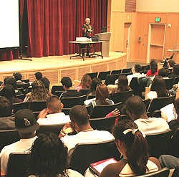

Slide 81
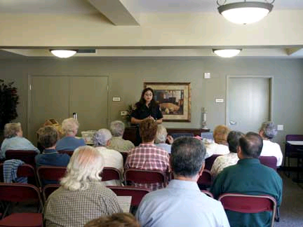

Slide 82


Slide 83


Slide 84
Identification
Creating a bond with listeners by emphasizing common values, goals, and experiences.

Slide 85
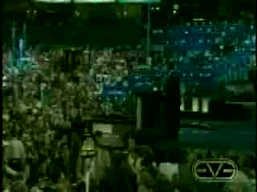
Barack Obama:
Adapting to the Audience

Slide 86
Egocentrism
The tendency of people to be concerned above all with their own values, beliefs, and well-being.

Slide 87
Stereotyping
Creating an oversimplified image
of a particular group of people, usually by assuming that all members of the group are alike.

Slide 88
Getting Information about the Audience
Questionnaires
  Fixed-alternative questions
  Scale questions
  Open-ended questions
Fixed-Alternative Questions
  Questions that offer a fixed choice between two or more alternatives.

Slide 89
Fixed-Alternative Question
Do you know what the insanity plea is
in the U.S. legal system?
Yes___________
No____________
Not Sure_______

Slide 90
Scale Questions
Questions that require responses
at fixed intervals along a scale of answers.

Slide 91
Scale Question
Do you agree or disagree with the following: Expert psychologists can determine with a high degree of accuracy whether or not a defendant is criminally insane.
strongly
agree
mildly
agree
mildly
disagree
strongly
disagree
undecided

Slide 92
Open-Ended Questions
Questions that allow respondents to answer however they want.

Slide 93
Open-Ended Question
What is your opinion about the insanity plea in U.S. court cases?

Slide 94
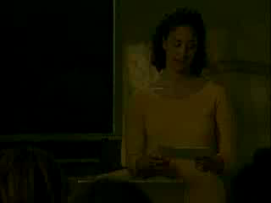
Using Audience-Analysis Questionnaires

Slide 95
6
Gathering Materials
Notes:
Chapter 6
Title Slide
Gathering Materials
Using Your Own Knowledge and Experience
Library Resources
Catalogue
Periodical Database
Abstract
Reference Works
Types of Reference Works
Internet Search Aids
Search Engines
Metasearch Engines
Virtual Library
Invisible Web
Searching the Internet
Specialized Research Resources
Evaluating Internet Documents
Bookmarks
Searching the Internet
Research Interview
Tips for Doing Research
Efficient Note-Taking
Tips for Doing Research
Tips for Doing Research
Tips for Doing Research
Tips for Doing Research
Blank

Slide 96
Using Your Own Knowledge and Experience
Your personal experiences can sometimes supply many supporting materials for your speeches.

Slide 97
Tips for Doing Research
Start early
Make a preliminary bibliography
Take notes efficiently
Think about your materials as you research

Slide 98
Evaluating Internet and Other
Documents
Authorship
Sponsorship
Recency

Slide 99
Research Interview
An interview conducted to gather information for a speech.

Slide 100
Citing Research in a Speech
Journal or book reference:
  Authors last name
  Year of publication
Newspaper or magazine article:
  Authors last name
  Name of newspaper/magazine
  Date of publication
Personal Interview
  Name of person interviewed
  Why they are the expert
  Month and year interview was conducted
Internet
  Name of internet site (not www address)
  Date accessed

Slide 101
7
Supporting Your Ideas
Notes:
Chapter 7
Title Slide
Supporting Your Ideas
Supporting Materials
Example
Types of Examples
Brief Examples
Extended Examples
Extended Example (video)
Hypothetical Examples
Hypothetical Example (video)
Tips for Using Examples
Tips for Using Examples (continued)
Statistical Measures
Tips for Using Statistics
Tips for Using Statistics (continued)
Explaining Statistics (video)
Testimony
Expert Testimony
Peer testimony
Direct quotation
Paraphrase
Tips for Using Testimony
Identifying the Source of Testimony (video)

Slide 102
Supporting Materials
Examples
Statistics
Testimony

Slide 103
1. Example
A specific case used to illustrate or
to represent a group of people, ideas, conditions, experiences, or the like.

Slide 104
Types of Examples
Brief examples
Extended examples
Hypothetical examples

Slide 105
Brief Example
A specific case referred to in passing to illustrate a point.

Slide 106
Extended Example
A story, narrative, or anecdote developed at some length to illustrate a point.

Slide 107

Using Extended Examples

Slide 108
Hypothetical Example
An example that describes an imaginary or fictitious situation.

Slide 109
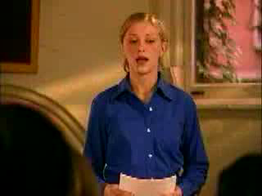
Using Hypothetical Examples

Slide 110
Tips for Using Examples
Use examples to clarify your ideas
Use examples to reinforce your ideas
Use examples to personalize your ideas

Slide 111
Tips for Using Examples
Make your examples vivid and richly textured
Practice delivery to enhance your extended examples

Slide 112
2. Statistical Measures
Mean
Median
Mode

Slide 113
Mean
The average value of a group of numbers.

Slide 114
Median
The middle figure in a group once the figures are put in order from the highest to the lowest.

Slide 115
Mode
The number that occurs most frequently in a group of numbers.

Slide 116
Tips for Using Statistics
Make sure the statistics are from a reliable source
Use statistics to quantify your ideas
Use statistics sparingly
Identify the sources of your statistics

Slide 117
Tips for Using Statistics
Explain your statistics
Round off complicated statistics
Use visual aids to clarify statistical trends

Slide 118
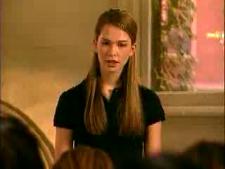
Explaining Statistics

Slide 119
3. Testimony
Quotations or paraphrases used to support a point.

Slide 120
Expert Testimony
Testimony from people who are recognized experts in their fields.

Slide 121
Peer Testimony
Testimony from ordinary people with firsthand experience or insight on a topic.

Slide 122
Direct Quotation
Testimony that is presented word
for word.

Slide 123
Quoting Out of Context
Distorting a statement’s meaning by removing the statement from the words and phrases surrounding it.

Slide 124
Paraphrase
To restate or summarize a source’s ideas in one’s own words.

Slide 125
Tips for Using Testimony
Quote or paraphrase accurately
Use testimony from qualified sources
Use testimony from unbiased sources
Identify the people you quote or paraphrase

Slide 126
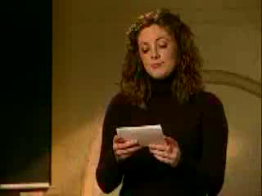
Identifying the Source of Testimony

Slide 127
Chapter 8
Organizing the Body of the Speech
Notes:
Chapter 8
Title Slide
Organizing the Body of the Speech
Strategic organization
Main Points
Tips for Preparing Main Points
Chronological Order
Example of Chronological Order
Spatial Order
Example of Spatial Order
Casual Order
Example of Casual Order
Problem-Solution Order
Example of Problem-Solution Order
Topical Order
Example of Topical Order
Tips for Preparing Main Points
Supporting Materials
Connective
Types of Connectives
Transition
Example of Transitions
Example of Transitions (video)
Internal Preview
Example of an Internal Preview
Transition Combined with an Internal Preview
Internal Summary
Example of an Internal Summary
Signposts
Example of Signposts
Blank

Slide 128
Strategic Organization
Putting a speech together in a particular way to achieve a particular result with a particular audience.

Slide 129
Main Points
The major points developed in the body of a speech.

Slide 130
Tips for Preparing
Main Points
Keep main points separate
Try to use the same pattern
of wording for main points
Balance the amount of time devoted to main points

Slide 131
Types of Organization Pattern
Chronological Order
Spatial Order
Causal Order
Problem Solution Order
Topical Order

Slide 132
Chronological Order
A method of speech organization in which the main points follow a time pattern.

Slide 133
Chronological Order
Specific Purpose: To inform my audience how the
Great Wall of China was built.
Main Points: I. Building of the Great Wall began
during the Qin dynasty of
221-206 B.C.
II. New sections of the Great Wall
were added during the Han
dynasty of 206 B.C.-220 A.D.
III. The Great Wall was completed
during the Ming Dynasty of
1368-1644.

Slide 134
Spatial Order
A method of speech organization in which the main points follow a directional pattern.

Slide 135
Spatial Order
Specific Purpose: To inform my audience about the structure of a hurricane.
Main Points: I. At the center of a hurricane is the calm, cloud-free eye.
II. Surrounding the eye is the eyewall, a dense ring of clouds that produces the most intense wind and rainfall.
III. Rotating around the eyewall are large bands of clouds and precipitation called spiral rain bands.

Slide 136
Causal Order
A method of speech organization in which the main points show a cause-effect relationship.

Slide 137
Causal Order
Specific Purpose: To inform my audience about the
possible causes for the collapse
of Mayan civilization.
Main Points: I. Mayan civilization flourished for
over a thousand years until 900
A.D., when it mysteriously began
to disintegrate. (EFFECT)
II. Scholars have advanced three
major explanations for the causes
of this disintegration. (CAUSE)

Slide 138
Problem-Solution Order
A method of speech organization in which the first main point deals with the existence and seriousness of a problem and the second main point presents a solution to the problem.

Slide 139
Problem-Solution Order
Specific Purpose: To persuade my audience that
legislation is needed to control
the abuses of fraudulent charity fund-raisers.
Main Points: I. Fraudulent charity fund-raising
has become a widespread
national problem.
II. The problem can be solved by a
combination of government
initiative and individual awareness.

Slide 140
Topical Order
A method of speech organization in which the main points divide the topic into logical and consistent subtopics.

Slide 141
Topical Order
Specific Purpose: To inform my audience about
the achievements of Ida
Wells-Barnett.
Main Points: I. As a teacher, Wells-Barnett spoke out against inferior school facilities for African-American children.
II. As a journalist, Wells-Barnett campaigned against lynching.
III. As a civic organizer, Wells- Barnett helped found the NAACP.

Slide 142
Connective
A word or phrase that connects the ideas of a speech and indicates the relationship between them.

Slide 143
Types of Connectives
Transition
Signpost
Internal preview
Internal summary

Slide 144
Transition
A word or phrase that indicates when a speaker has finished one thought and is moving on to another.

Slide 145
Transitions
Now that we have seen how drinking too much is a serious problem for students and their communities,
let us look at some causes.
So much for the present; what about the future?

Slide 146
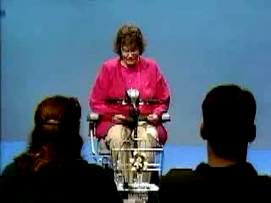
Using Transitions

Slide 147
Signpost
A very brief statement that indicates where a speaker is in the speech or that focuses attention on key ideas.

Slide 148
Signposts
The first cause of the global lack of food is inefficient agricultural production.
The second cause of global lack of food is drought in the affected countries.
The final cause of global lack of food is mismanagement of available resources by local leaders.

Slide 149
Internal Preview
A statement in the introduction of the speech that lets the audience know what the speaker is going to discuss next.

Slide 150
Internal Preview
“In discussing how Asian Americans have been stereotyped in the mass media, we’ll look first at the origins of the problem and second at its continuing impact today.”

Slide 151
Internal Summary
A statement in the conclusion of the speech that summarizes the speaker’s preceding point or points.

Slide 152
Internal Summary
“In short, palm reading is an ancient art. Developed in China more than 5,000 years ago, it was practiced in classical Greece and Rome, flourished during the Middle Ages, survived the Industrial Revolution, and remains popular today.”

Slide 153
Chapter 9
Beginning and Ending the Speech
Notes:
Chapter 9
Title Slide
Beginning and Ending the Speech
The Introduction
Methods of Gaining Attention
Relating the Topic to the Audience
Relating the Topic to the Audience
Credibility
Goodwill
Rhetorical Question
Preview Statement
Examples of Preview Statements
Example of a Complete Introduction
Tips for Preparing the Introduction
The Conclusion
Crescendo Ending
Example of a Crescendo Ending
Dissolve Ending
Methods of Reinforcing the Central Idea
Tips for Preparing the Conclusion
Summarizing in a
Speech Conclusion
Linking the Conclusion
to the Introduction
Blank

Slide 154
The Introduction
Get attention and interest
Reveal the topic
Establish credibility and goodwill
Preview the body of the speech

Slide 155
Methods of
Gaining Attention
Relate your topic to the audience
State the importance of your topic
Startle the audience
Arouse the curiosity of the audience
Question the audience
Begin with a quotation
Tell a story

Slide 156
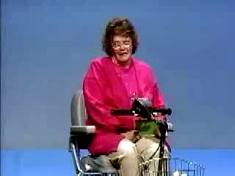
Relating to the Audience

Slide 157

Relating to the Audience

Slide 158
Credibility
The audience’s perception of whether
a speaker is qualified to speak on a given topic.

Slide 159
Goodwill
The audience’s perception of whether the speaker has the best interests of the audience in mind.

Slide 160
Rhetorical Question
A question that the audience answers mentally rather than out loud.

Slide 161
Preview Statement
A statement in the introduction of a speech that identifies the main points to be discussed in the body of the speech.

Slide 162
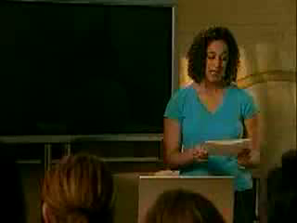
Preview Statements

Slide 163

Complete Introduction:
Informative Speech

Slide 164
Complete Introduction:
Persuasive Speech

Slide 165
Tips for Preparing the Introduction
Be concise: Usually no more than
10-20 percent of the total speech
Look for possible introductory materials as you do your research
Be creative in devising your introduction

Slide 166
Tips for Preparing the Introduction
Finalize the exact wording of your introduction after you have finished preparing the body of the speech
Work out the content and delivery
of your introduction in detail

Slide 167
The Conclusion
Signal the end of the speech
Reinforce the central idea

Slide 168
Crescendo Ending
A conclusion in which the speech builds to a zenith of power and intensity.

Slide 169
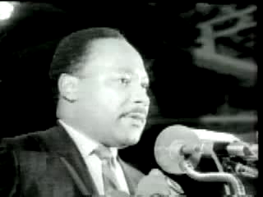
Using a Crescendo Ending
Insert clip 9.4
Martin Luther King, Jr.,
“I’ve Been to the Mountaintop”

Slide 170
Dissolve Ending
A conclusion that generates emotional appeal by fading step by step to a dramatic final statement.

Slide 171
Methods of Reinforcing the Central Idea
Summarize your speech
End with a quotation
Make a dramatic statement

Slide 172
Tips for Preparing the Conclusion
Look for possible concluding materials as you do your research
Conclude with a bang, not a whimper
Be brief: Usually no more than 5-10 percent of the total speech
Work out the content and delivery of your conclusion in detail

Slide 173
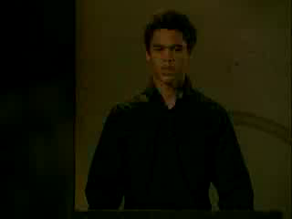
Summarizing in a Speech Conclusion

Slide 174
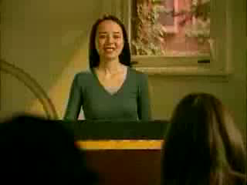
Linking the Conclusion to the Introduction

Slide 175
10
Outlining the Speech
Notes:
Chapter 10
Title Slide
Outlining the Speech
Preparation Outline
Guidelines for the Preparation Outline
Guidelines for the Preparation Outline
Visual Framework
Example of Visual Framework
Bibliography
Speaking Outline
Guidelines for the Speaking Outline
Delivery cues
Blank Slide

Slide 176
Guidelines for the
Preparation Outline
Identify the pattern of arrangement for your speech (i.e. topical, spatial)
State the specific purpose of your speech
Identify the central idea
Label the introduction, body, and conclusion
Use a consistent pattern of symbolization and indentation

Slide 177
Guidelines for the
Preparation Outline
State main points and subpoints in full sentences
Label transitions, internal summaries, and internal previews
Attach a bibliography/reference page
Model your outline like the handout in class

Slide 178
Visual Framework
The pattern of symbolization and indentation in a speech outline that shows the relationships among the ideas of the speech.

Slide 179
Example of Visual Framework
Main point
  Subpoint
  Subpoint
    Sub-subpoint
    Sub-subpoint
Main point
  Subpoint
    Sub-subpoint
    Sub-subpoint
  Subpoint

Slide 180
Speaking Outline
A brief outline used to jog a speaker’s memory during the presentation.

Slide 181
Guidelines for the
Speaking Outline
Follow the visual framework used in the preparation outline
Make sure the outline is plainly legible
Keep the outline as brief as possible
Give yourself cues for delivering the speech

Slide 182
Delivery cues
Directions in a speaking outline to help a speaker remember how she or he wants to deliver key parts of the speech.

Slide 183
Citing your sources in your speech
Book Reference
  Include the author, and name of book.
    According to Jeremy Taylor, author of Finances for the Future, published in 2007, “The average person spends 1.5 times their annual income on personal, non-necessity items.”
Magazine, Journal, Newspaper Reference
  Include the author, name of magazine, etc.., and name of article.
    According to a Times article entitled “What to do with your peaches” written by Nancy Drew, peaches are best bottled when they are freshly packed in jars with a Tbsp of lemon juice.

Slide 184
Citing your Sources
Internet Reference
  Include the title of the internet site and author, if applicable.
    According to the US Department of Agriculture website, the average cow eats 10 bails of hay per month.
    According to The National AIDS Society webpage, updated by Charles Fin, AIDS is on the rise in Africa.
Interview Reference
  Include the name of the person interviewed, qualifications, and Month/Year when interviewed.
    According to a March 2007 interview with Nancy Drew, a famous crime investigator in England, Criminals should go directly to jail.

Slide 185
11
Using Language
Notes:
Chapter 11
Title Slide
Using Language
Language is Important
Denotative Meaning
Connotative Meaning
Guidelines for Using Language Accurately
Clearly
Abstract vs. Concrete Language
Imagery
Using Imagery in a Speech
Concrete words
Abstract words
Simile
Example of Simile
Metaphor
Example of Metaphor
Mixed Metaphors
Using Metaphor in a Speech
Rhythm
Using Rhythm in a Speech
Parallelism
Example of Parallelism
Repetition
Example of Repetition
Alliteration
Example of Alliteration
Antithesis
Example of Antithesis
Using Language Appropriately
Inclusive Language
Using Inclusive Language
Avoid the Generic "He"
Avoid the Use of "Man"
Avoid Stereotyping Jobs and Social Roles
Avoid Unnecessary Personal Traits
Use Names that Groups Use to Identify Themselves
Blank

Slide 186
Guidelines for Using
Language
Accurately
Clearly
Vividly
Appropriately

Slide 187
Imagery
The use of vivid language to create mental images of objects, actions, or ideas.

Slide 188
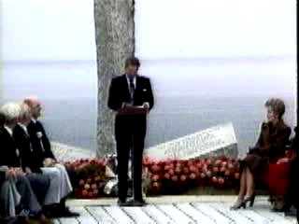
Using Imagery
Ronald Reagan,
“Remarks at the U.S. Ranger Monument on the
40th Anniversary of D-Day”

Slide 189
Simile
An explicit comparison, introduced with the word “like” or “as,” between things that are essentially different
yet have something in common.

Slide 190
Simile
“Air pollution is eating away at the monuments in Washington, D.C.,
like a giant Alka-Seltzer tablet.”

Slide 191
Metaphor
An implicit comparison, not introduced with the word “like” or “as,” between two things that are essentially different yet have something in common.

Slide 192
Metaphor
“America’s cities are the windows through which the world looks at American society.”

Slide 193
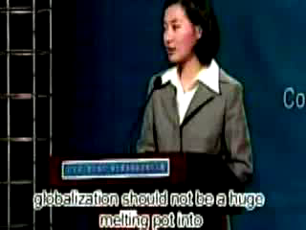
Using Metaphor

Slide 194
Rhythm
The pattern of sound in a
speech created by the choice
and arrangement of words.

Slide 195
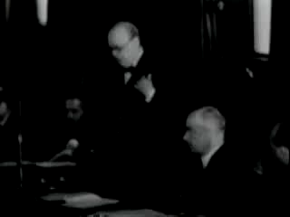
Using Rhythm
Winston Churchill,
“Address to the Dominion High Commissioners and
Allied Countries’ Ministers Conference”

Slide 196
Parallelism
The similar arrangement of a pair
or series of related words, phrases,
or sentences.

Slide 197
Parallelism
“Rich and poor, intelligent and ignorant, wise and foolish, virtuous and vicious, man and woman—it is ever the same, each soul must depend wholly on itself.”

Slide 198
Repetition
Reiteration of the same word or set of words at the beginning or end of successive clauses or sentences

Slide 199
Repetition
“We will not tire, we will not falter, and we will not fail.”

Slide 200
Alliteration
Repetition of the initial consonant sound of close or adjoining words.

Slide 201
Alliteration
“In a nation founded on the promise
of human dignity, our colleges, our communities, our country should challenge hatred wherever we find it.”

Slide 202
Antithesis
The juxtaposition of contrasting ideas, usually in parallel structure.

Slide 203
Antithesis
“Ask not what your country can do for you; ask what you can do for your country.”

Slide 204
Using Language Vividly

Slide 205
Using Language
Appropriately
Appropriateness to the occasion
Appropriateness to the audience
Appropriateness to the topic
Appropriateness to the speaker

Slide 206
Inclusive Language
Language that does not stereotype, demean, or patronize people on the basis of gender, race, religion, disability, sexual orientation, or other factors.

Slide 207
Using Inclusive Language
Avoid the generic “he”
Avoid the use of “man” when referring to both men and women
Avoid stereotyping jobs and social roles by gender

Slide 208
Using Inclusive Language
Avoid identifying personal traits unrelated to the topic
Use names that groups use to identify themselves

Slide 209
12
Delivery
Notes:
Chapter 12
Title Slide
Delivery
Nonverbal Communication
Methods of Speech Delivery
Manuscript Speech
Impromptu Speech
Extemporaneous Speech
Impromptu-Extemporaneous
Conversational Quality
Using Conversational Quality
Using Conversational Quality
The Speaker’s Voice
Volume
Pitch
Rate
Pauses
Vocalized Pauses
Vocal Variety
Using Vocal Variety
Pronunciation
Articulation
Dialect
The Speaker’s Body
Using Gestures and Eye Contact
Using Gestures and Eye Contact
Kinesics
Practicing Delivery
Preparing for the Question-and-Answer Session
Managing the Question-and-Answer Session
Blank Slide

Slide 210
Nonverbal Communication
Communication based on a person’s use of voice and body, rather than on the use of words.

Slide 211
Conversational Quality
Presenting a speech so it sounds spontaneous no matter how many times it has been rehearsed.

Slide 212
The Speaker’s Voice
Volume
Pitch
Rate
Pauses
Vocal variety
Pronunciation
Articulation

Slide 213
Vocalized Pauses
Pauses that occur when a speaker fills the silence between words with vocalizations such as “uh,” “er,” and “um.”

Slide 214
The Speaker’s Body
Personal appearance
Movement
Gestures
Eye contact

Slide 215
Movement
Move with your transition statements.
Move and plant. Make sure you aren’t moving the whole time.
Try to cover both sides of the room.

Slide 216
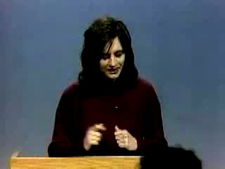
Using Gestures and Eye Contact

Slide 217
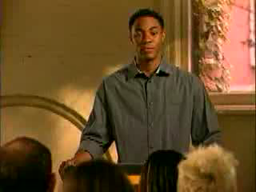
Using Gestures and Eye Contact

Slide 218
Practicing Delivery
Go through your preparation outline aloud to see how it translates into spoken discourse.
Prepare your speaking outline.
Practice the speech aloud several times.
Polish and refine your delivery.
Give your speech a dress rehearsal.

Slide 219
13
Using Visual Aids

Slide 220
Advantages of Visual Aids
Clarity
Interest
Retention
Credibility
Persuasiveness

Slide 221
Kinds of Visual Aids
Objects
Models
Photographs
Drawings
Graphs

Slide 222
Kinds of Visual Aids
Charts
Video
Transparencies
Multimedia presentations

Slide 223
Photographs
Must be large enough to be seen easily by all listeners
Convert photographs to
transparencies and show them
with an overhead projector
Show photographs with PowerPoint or another multimedia program

Slide 224
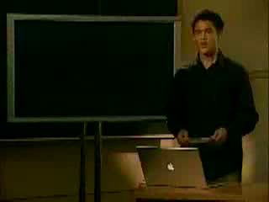
Using a Photograph

Slide 225
Drawings
Can be a useful alternative to photographs
Must be large enough to be seen easily by all listeners

Slide 226


Slide 227
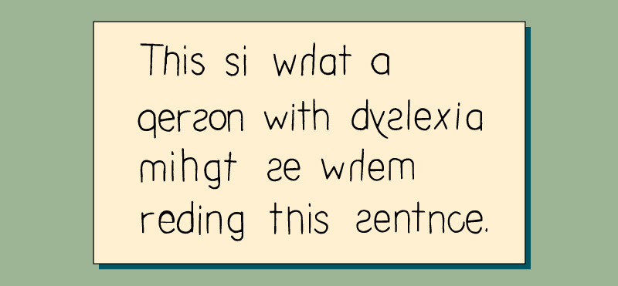

Slide 228


Slide 229
Graphs
Visual aids used to show statistical trends and patterns.

Slide 230
Line Graph
A graph that uses one or more lines
to show changes in statistics over
time or space.

Slide 231
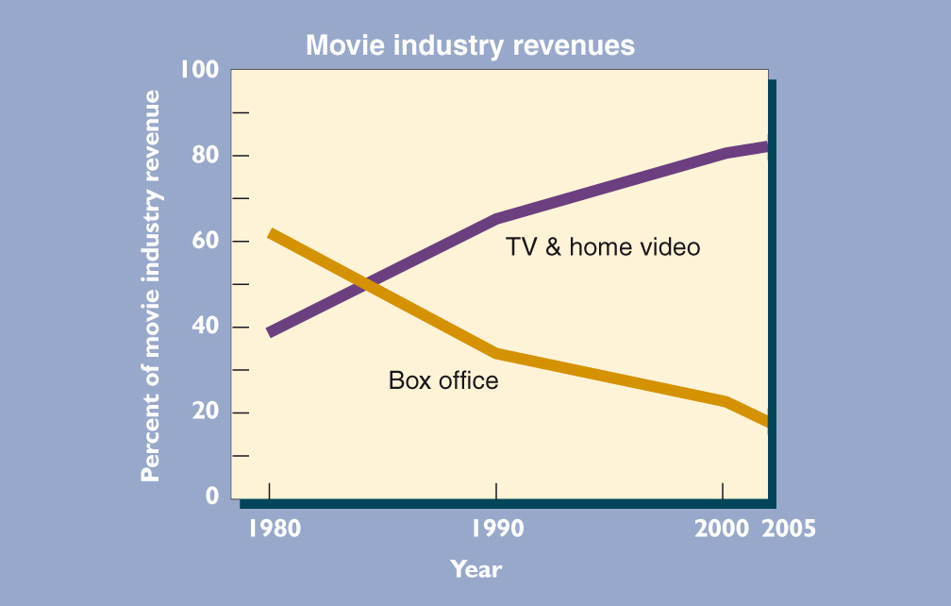

Slide 232
Pie Graph
A graph that highlights segments of
a circle to show simple distribution patterns.

Slide 233
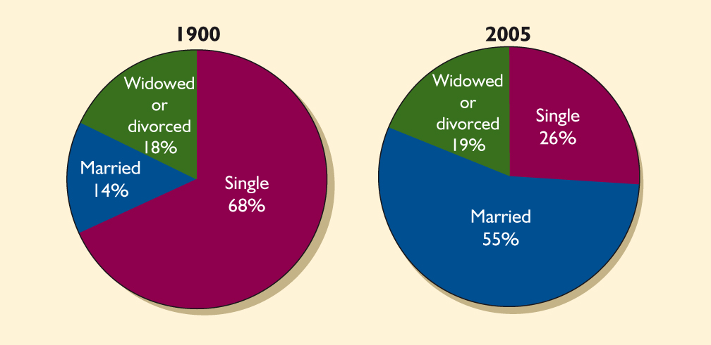

Slide 234
Bar Graph
A graph that uses vertical or horizontal bars to show comparisons among two or more items.

Slide 235
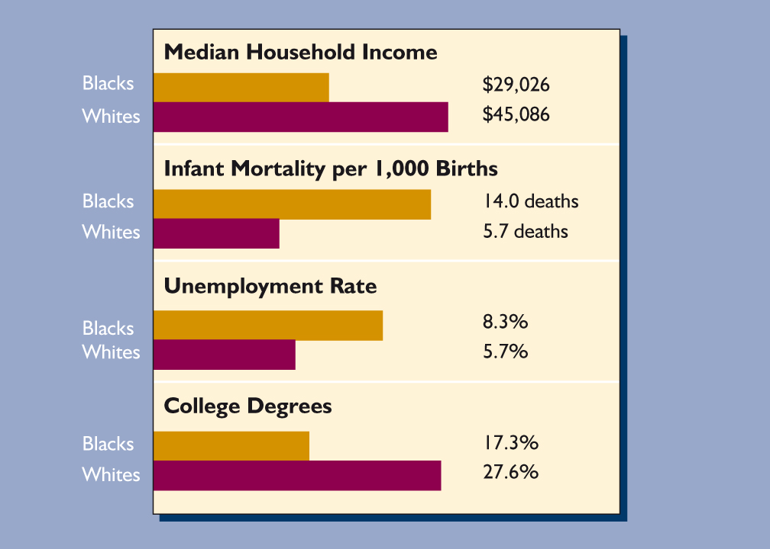

Slide 236
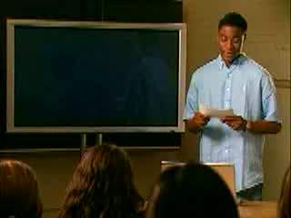
Using a Graph

Slide 237
Chart
A visual aid that summarizes a
large block of information, usually
in list form.

Slide 238
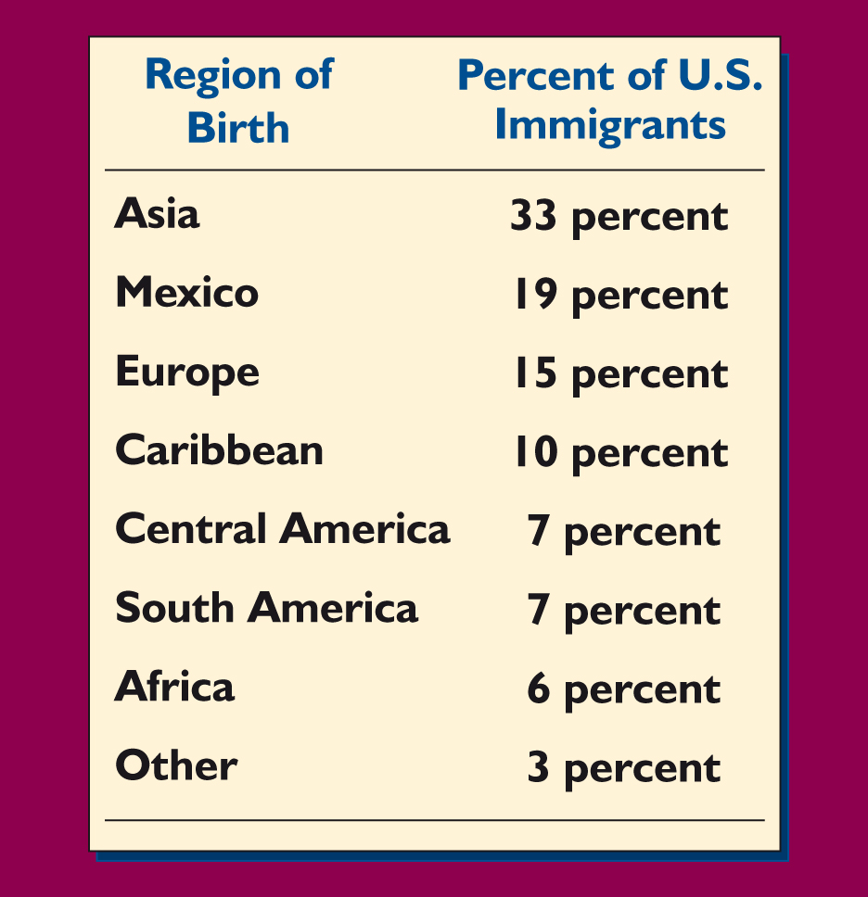

Slide 239

Using a Chart

Slide 240
Transparencies
Visual aids drawn, written, or printed on sheets of clear acetate and shown with an overhead projector.

Slide 241
Video
Use video only when it is essential
to communicate your message
Edit video so it is smoothly integrated into your speech
Make sure you can run the video equipment properly

Slide 242
Multimedia Presentation
A speech that combines several
kinds of visual and/or audio aids
in the same talk.

Slide 243
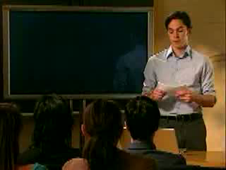
Using Multimedia Resources

Slide 244
Guidelines for Preparing
Visual Aids
Prepare visual aids in advance
Keep visual aids simple
Make sure visual aids are large enough
Use fonts that are easy to read
Use a limited number of fonts
Use color effectively

Slide 245
Guidelines for Presenting Visual Aids
Avoid using the chalkboard for visual aids
Display visual aids where listeners can see them
Avoid passing visual aids among the audience

Slide 246
Guidelines for Presenting Visual Aids
Display visual aids only while discussing them
Talk to the audience, not to your visual aid
Explain visual aids clearly and concisely
Practice with your visual aids

Slide 247
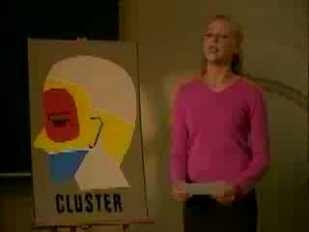
Explaining Visual Aids

Slide 248
18
Speaking in Small Groups
Notes:
Chapter 18
Speaking in Small Groups
What Is a Small Group?
Dyad
Problem-Solving Group
Kinds of Group Leaders
Implied Leader
Emergent Leader
Designated Leader
Group Needs
Procedural Needs
Task Needs
Maintenance Needs
Responsibilities in a Small Group
Hidden Agendas
The Reflective-Thinking Method
The Reflective-Thinking Method
Question of Policy
Guidelines for Discussion Questions
Make the Question Clear and Specific
Phrase the Question to Allow for a Wide Range of Answers
Avoid Biased or Slanted Questions
Pose a Single Question
Pose a Single Question
Criteria
Brainstorming
Consensus
Presenting Group Recommendations
Oral Report
Symposium
Panel Discussion
Blank

Slide 249
Small Group
A collection of 3 to 12 people who assemble for a specific purpose.

Slide 250
Leadership
The ability to influence group members so as to help achieve
the goals of the group.

Slide 251
Kinds of Group Leaders
Implied leader
Emergent leader
Designated leader

Slide 252
Implied Leader
A group member to whom other members defer because of her or
his rank, expertise, or other quality.

Slide 253
Emergent Leader
A group member who emerges
as a leader during the group's deliberations.

Slide 254
Designated Leader
A person who is elected or appointed as leader when the group is formed.

Slide 255
Group Needs
Procedural needs
Task needs
Maintenance needs

Slide 256
Procedural Needs
Routine “housekeeping” actions necessary for the efficient conduct of business in a small group.

Slide 257
Task Needs
Substantive actions necessary to help a small group complete its assigned task.

Slide 258
Maintenance Needs
Communicative actions necessary
to maintain interpersonal relations
in a small group.

Slide 259
Responsibilities in a
Small Group
Be committed to the group’s goals
Fulfill individual assignments
Avoid interpersonal conflicts
Encourage full participation
Keep the discussion on track

Slide 260
Hidden Agenda
A set of unstated individual goals
that may conflict with the goals of
the group as a whole.

Slide 261
Reflective-Thinking Method
A five-step method for directing discussion in a problem-solving
small group.

Slide 262
Steps of the Reflective-Thinking Method
Define the problem
Analyze the problem
Establish criteria for solutions
Generate potential solutions
Select the best solution

Slide 263
Guidelines for Discussion Questions
Make the question clear and specific
Phrase the question to allow for a wide range of answers
Avoid biased or slanted questions
Pose a single question

Slide 264
Make the Question
Clear and Specific
Ineffective: What should be done about
fraudulent charities?
More Effective: What should the federal government do to control the activities of fraudulent charities?

Slide 265
Phrase the Question to
Allow for a
Wide Range of Answers
Ineffective: Should our community
build more bike paths?
More Effective: What should our community
do to improve services for
bike riders?

Slide 266
Avoid Biased or Slanted Questions
Ineffective: How can we keep the
campus bookstore from
ripping off students?
More Effective: What changes, if any, should be made in the
pricing policies of the campus bookstore?

Slide 267
Pose a Single Question
Ineffective: What revisions should
our school consider in its
admissions requirements
and in its graduation
requirements?

Slide 268
More Effective: What revisions should our
school consider in its
admissions requirements?
OR
More Effective: What revisions should our
school consider in its
graduation requirements?

Slide 269
Consensus
A group decision that is acceptable
to all members of the group.

Slide 270
Presenting Group Recommendations
Oral report
Symposium
Panel

Slide 271
Oral Report
A speech presenting the findings, conclusions, decisions, etc. of a
small group.

Slide 272
Symposium
A public presentation in which several people present prepared speeches on different aspects of the same topic.

Slide 273
Panel Discussion
A structured conversation on a given topic among several people in front
of an audience.

