Slide 1
Argument and Debate
Malynda Bjerregaard
http://www.youtube.com/watch?v=NpVycRpa2L8&feature=PlayList&p=330D1650C4AC27C0&index=0&playnext=1

Slide 2


Chapter 1 & 2
Basics of Argumentatoin
Argumentation: A form of instrumental communication relying on reasoning and proof to influence belief or behavior

Slide 3
Elaboration Likelihood Model
Central Route
Involved to a high degree
Follow the quality of the arguments, soundness of reasoning, and believability of evidence
Must perceive compelling personal interest in what you have to say.
Peripheral Route
Used for simplification and efficiency purposes
Used when you must make decisions quickly and you aren’t that invested
Often you’ll rely on emotional appeals or other simple cue.

Slide 4
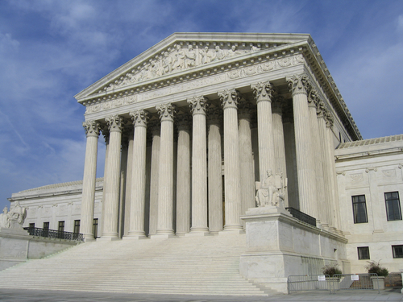
Strive for :
Clarity
Honesty
Efficiency
Relevance

Slide 5

Note pg. 20 Discourse Ethics 1-10

Slide 6
Chapter 2

Slide 7
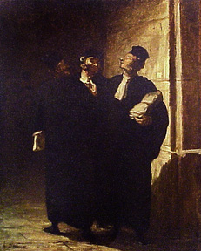
Argumentation is:
A social activity
An intellectual activity
A verbal activity
Opinion stating, justifying, or refuting
Directed toward an audience

Slide 8
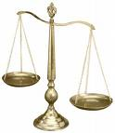
Presumption
Artificial presumption: Something that can be automatically assumed or stereotyped (i.e. US supreme court works for justice)
Natural Presumption: the natural order of where we are now. Would require persuasion to motivate change from current positions.

Slide 9

Burden of Proof
Most often Affirmative (Government) holds burden of proof because of natural presumption
Whoever is advocating change would have burden of proof

Slide 10
Prima Facie Case
A case that at first sight would justify changing belief or behavior
Must be upheld with evidence; first instincts are only temporary
Must be both topical (identify the broad, general topic to be argued) and inherent (addressing what the cause of the problem is and what change would be necessary)

Slide 11
Introduction Debates
10 minutes total (5 per day)
2 minute Affirmative (government)
1 minute cross x
2 minute Negative (opposition)
1 minute cross x
2 minute Affirmative rebuttal
2 minute Negative rebuttal

Slide 12
Affirmative Speaker (government)
Focus on the topic, define the parameters of the debate
Create 2-3 strong points (contentions)
Have a strong introduction and conclusion
Use the Cross X time to point out errors in your opponents reasoning. Question their main points. Bring up alternate examples, but phrase everything as a question

Slide 13
Negative Speaker (opposition)
Create 2-3 main points against the resolution
Prepare yourself for any take the affirmative could have on the resolution
Dedicate between ¼ to 1/3 of your speaking time (2 to 3 minutes) for refuting the affirmatives arguments and solidifying the claims that were made during cross X
Have a strong introduction and conclusion, urging your point of view.
Use cross X time to show weakness in Affirmative’s case. Bring up counter-examples but phrase everything as a question

Slide 14

Chapter Three
What am I going to argue about?

Slide 15
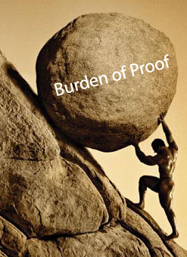
Nature of Proposition
Proposition: A statement that identifies the argumentative ground and points to a change in belief or behavior
Proposition will identify the limits of the topic of argument, place the burden of proof on the advocate, and give presumption to the opponent. (Note: proof is not burden of change).
Both sides should state the proposition during their introduction speech (AKA “…which is why I stand in firm negation of the proposition which states…”)

Slide 16
Select Terms for Definition
  Gov holds burden of definition. Opp can have definitions, but doesn’t have to
  Often this is the first argument of the debate
Specify Direction of Change
  Say whether you are addressing fact, value, or policy
  Identify clearly the part of the proposition statement that you want change implemented in
Identifying Key Issues
  Main area of focus in debate, usually your main points
The federal government should significantly strengthen the regulation of mass media in the United States

Slide 17
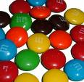
Propositions are either;
Proposition of Fact
Proposition of Value
Proposition of Policy

Slide 18

Proposition of Fact
Seek to alter beliefs under the assumption that something exists
Can be past fact, present fact, or future fact
(See pg. 45)
  i.e. ‘The lyrics of country-western music convey negative images of marriage and fidelity’
Controversy exists in trying to determine the truth of a statement

Slide 19
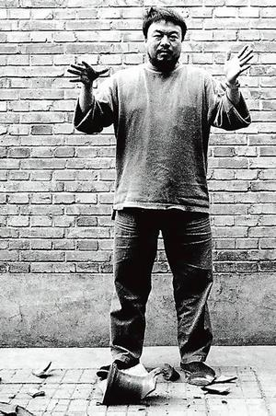
Proposition of Value
Alter belief by examining subjective reactions to things and our opinions of them.
Can be either:
  Singular value: straightforward evaluation
  ‘Reality television programming sacrifices quality for Nielsen ratings’
  Comparative value: contrast two or more subjects to determine which is more ‘valuable’ in a given situation
  ‘The rights of endangered animal species are more important than the rights of indigenous human populations’
Need to determine the value object (reality television programming) and value judgment term (quality)

Slide 20
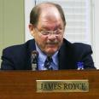

Proposition of Policy
Creates a change in behavior or a call to action
Usually includes word ‘should’ and means GOV will have to prove it is ‘necessary’ ‘desirable’ and ‘viable’
Resolved: That the federal government should guarantee an opportunity for higher education to all qualified high school graduates
Resolved: That greater controls should be imposed on the gathering and utilization of information about US citizens by government agencies
Resolved: That the Commander-in-chief power of the US President should be substantially controlled

Slide 21
GOV on policy proposition
Usually Propositions of Policy will follow these three main points for GOV:
  Factual main points showing rational for believing problem exists
  Evaluation main point looking at existing policies and showing their inadequacy and why perceived problem exists
  Superior policy action showing why GOV’s policy is the better plan of action
Resolved: That the federal government should guarantee an opportunity for higher education to all qualified high school graduates

Slide 22
Opp on Proposition of Policy
OPP will follow according to GOV’s main points
  Problems do not exist
  Evaluation GOV makes of current policy is biased and untrue, in fact current policy is strong
  Value judgment on the plan of the affirmative (i.e. proposed plan is weak and undesirable)
Resolved: That the federal government should guarantee an opportunity for higher education to all qualified high school graduates

Slide 23

Defining Key Terms
The purpose of defining terms is to identify key issues
Don’t use dictionary definitions
Create a definition that uses synonyms or examples

Slide 24
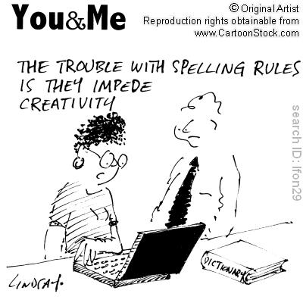
Rules of Definition
  Inclusionary rule: include terms that fall under the term
  Exclusionary Rule: Phrase definition to exclude things that don’t appropriate to the terms
  Adaptation Rule: meanings are appropriate to the figurative ground
  Neutrality rule: avoid unnecessary emption or bias
  Clarity rule: Don’t cloud your definition with unnecessary jargon

Slide 25
Terms needing definition
Equivocal terms (2 or more correct meanings)
Vague terms (anything ambiguous or lacking clear cut feel)
Technical terms (jargon specialized to a particular field)
New terms (words that would be unknown in our common vocabulary)
Coined terms (invented shorthand terms for complex ideas ‘oprahtization’

Slide 26
Define Terms by:
Synonym: a more familiar word similar to the term that substantiates your take on the proposition
Authority: Use a scholarly study, textbook, quote, or specialized dictionary (dictionary of genetics, dictionary of space technology, blacks law dictionary etc.
Example: Explain how something is to be understood by looking at examples
Function: Looking at what an object, instrument, agency, or concept performs
Operation: Explain how something works

