Slide 1

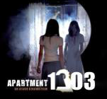

International Cinema presents…

Slide 2
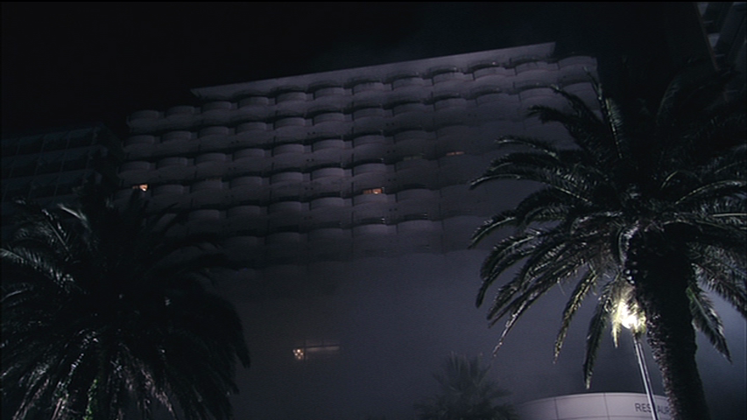
Hamamatsu City, Japan

Slide 3
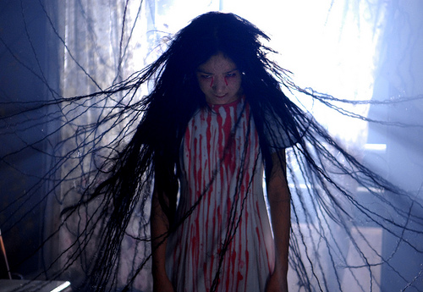
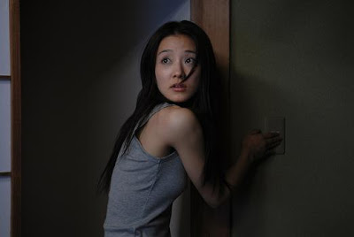
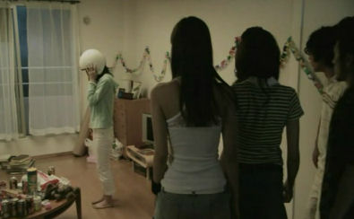
Party gone horribly wrong…
Terror!
Death!!!

Slide 4
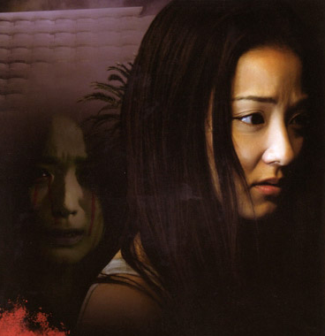
Uncover the bone-chilling secret…
…or tonight may be your LAST…
…in…
APARTMENT 1303

